Slide 1
CLINICAL CASE Bilateral neovascularization in Purtscher Retinopathy
Iuri Cardoso da Silva
Fellow - Retina and Vitreous - Unicamp

Slide 2
Case presentation - History
32 years old, white, male.
Complaint of bilateral progressive low vision.
Past medical history:
Direct chest trauma after motorcycle accident 4 months ago.
Ribs and clavicle fractures.
Medications:
None
Past ophthalmic history:
Ophthalmic bed examination 3 weeks after trauma: Suggestive fundoscopic findings of Purtscher retinopathy. (Purtscher flecken, Retinal hemorrhages and cotton-woll spots at the posterior pole and around the optic disc)
Later, the patient was referred to complete opthalmological evaluation.
Lost follow-up.

Slide 3
Current Ocular Examination* (*4 months after trauma)
Visual Acuity
BCVA
Right Eye: Counting fingers
Left Eye: Counting fingers
Anterior segment examination
Normal in both eyes
Intraocular pressure
Right eye: 12
Left eye: 12

Slide 4
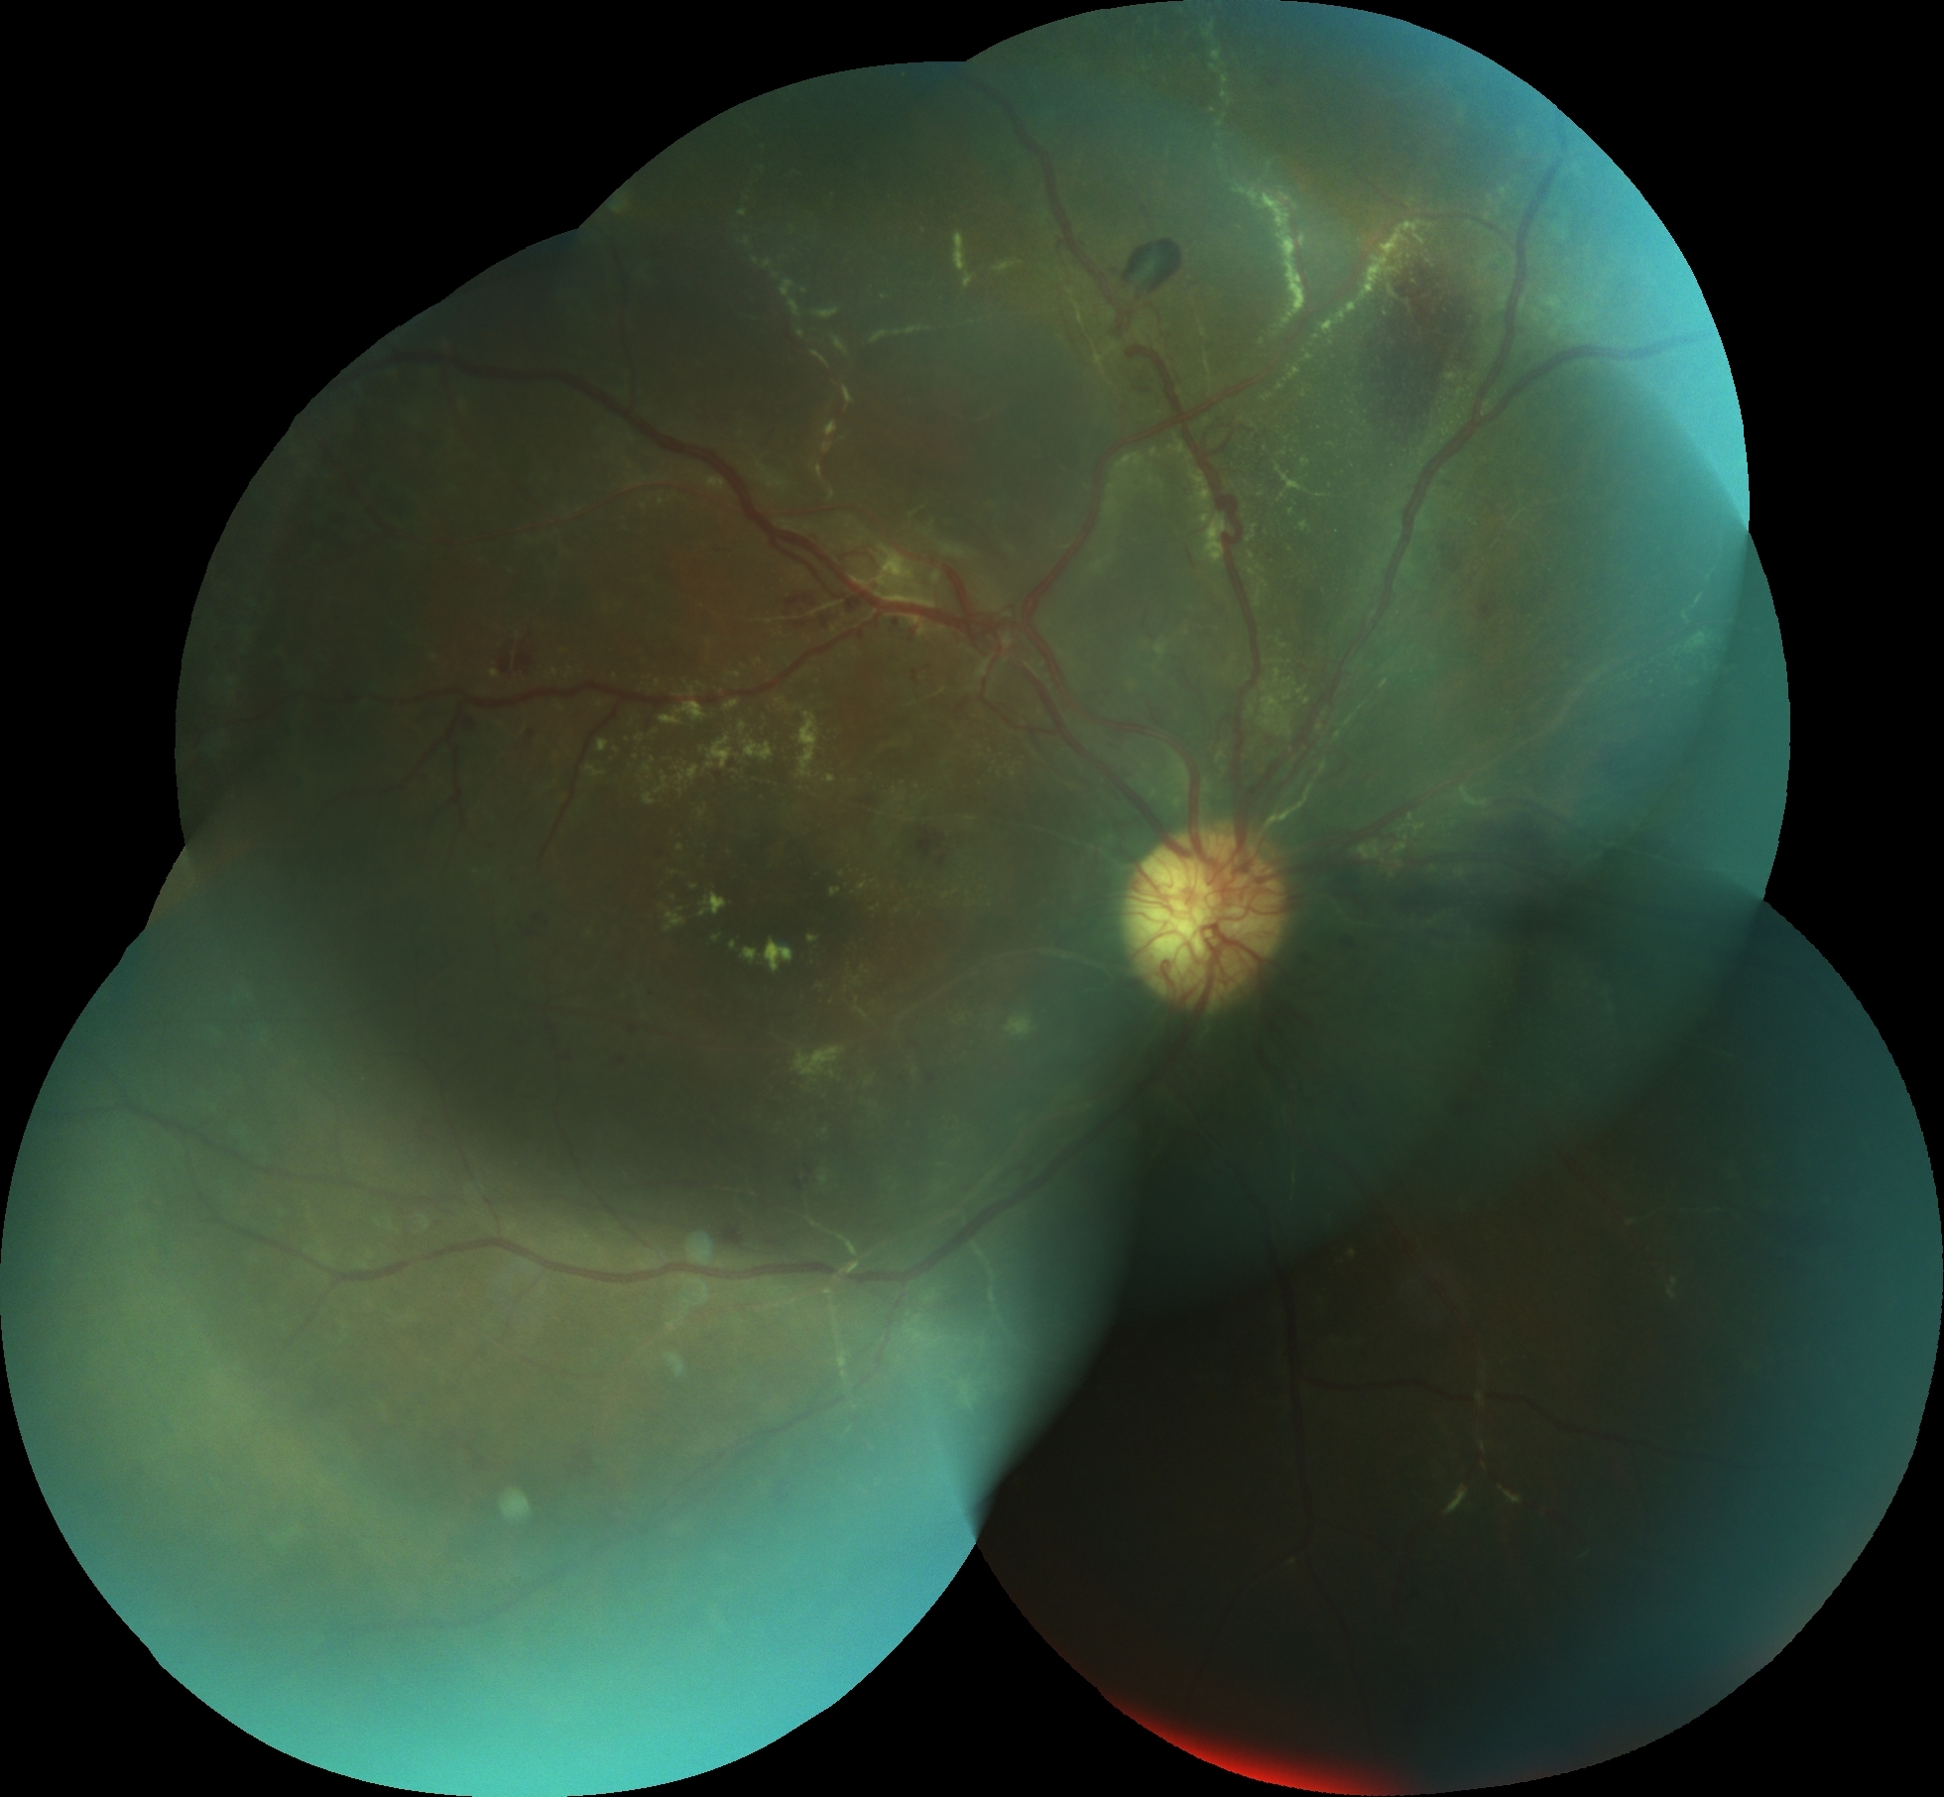
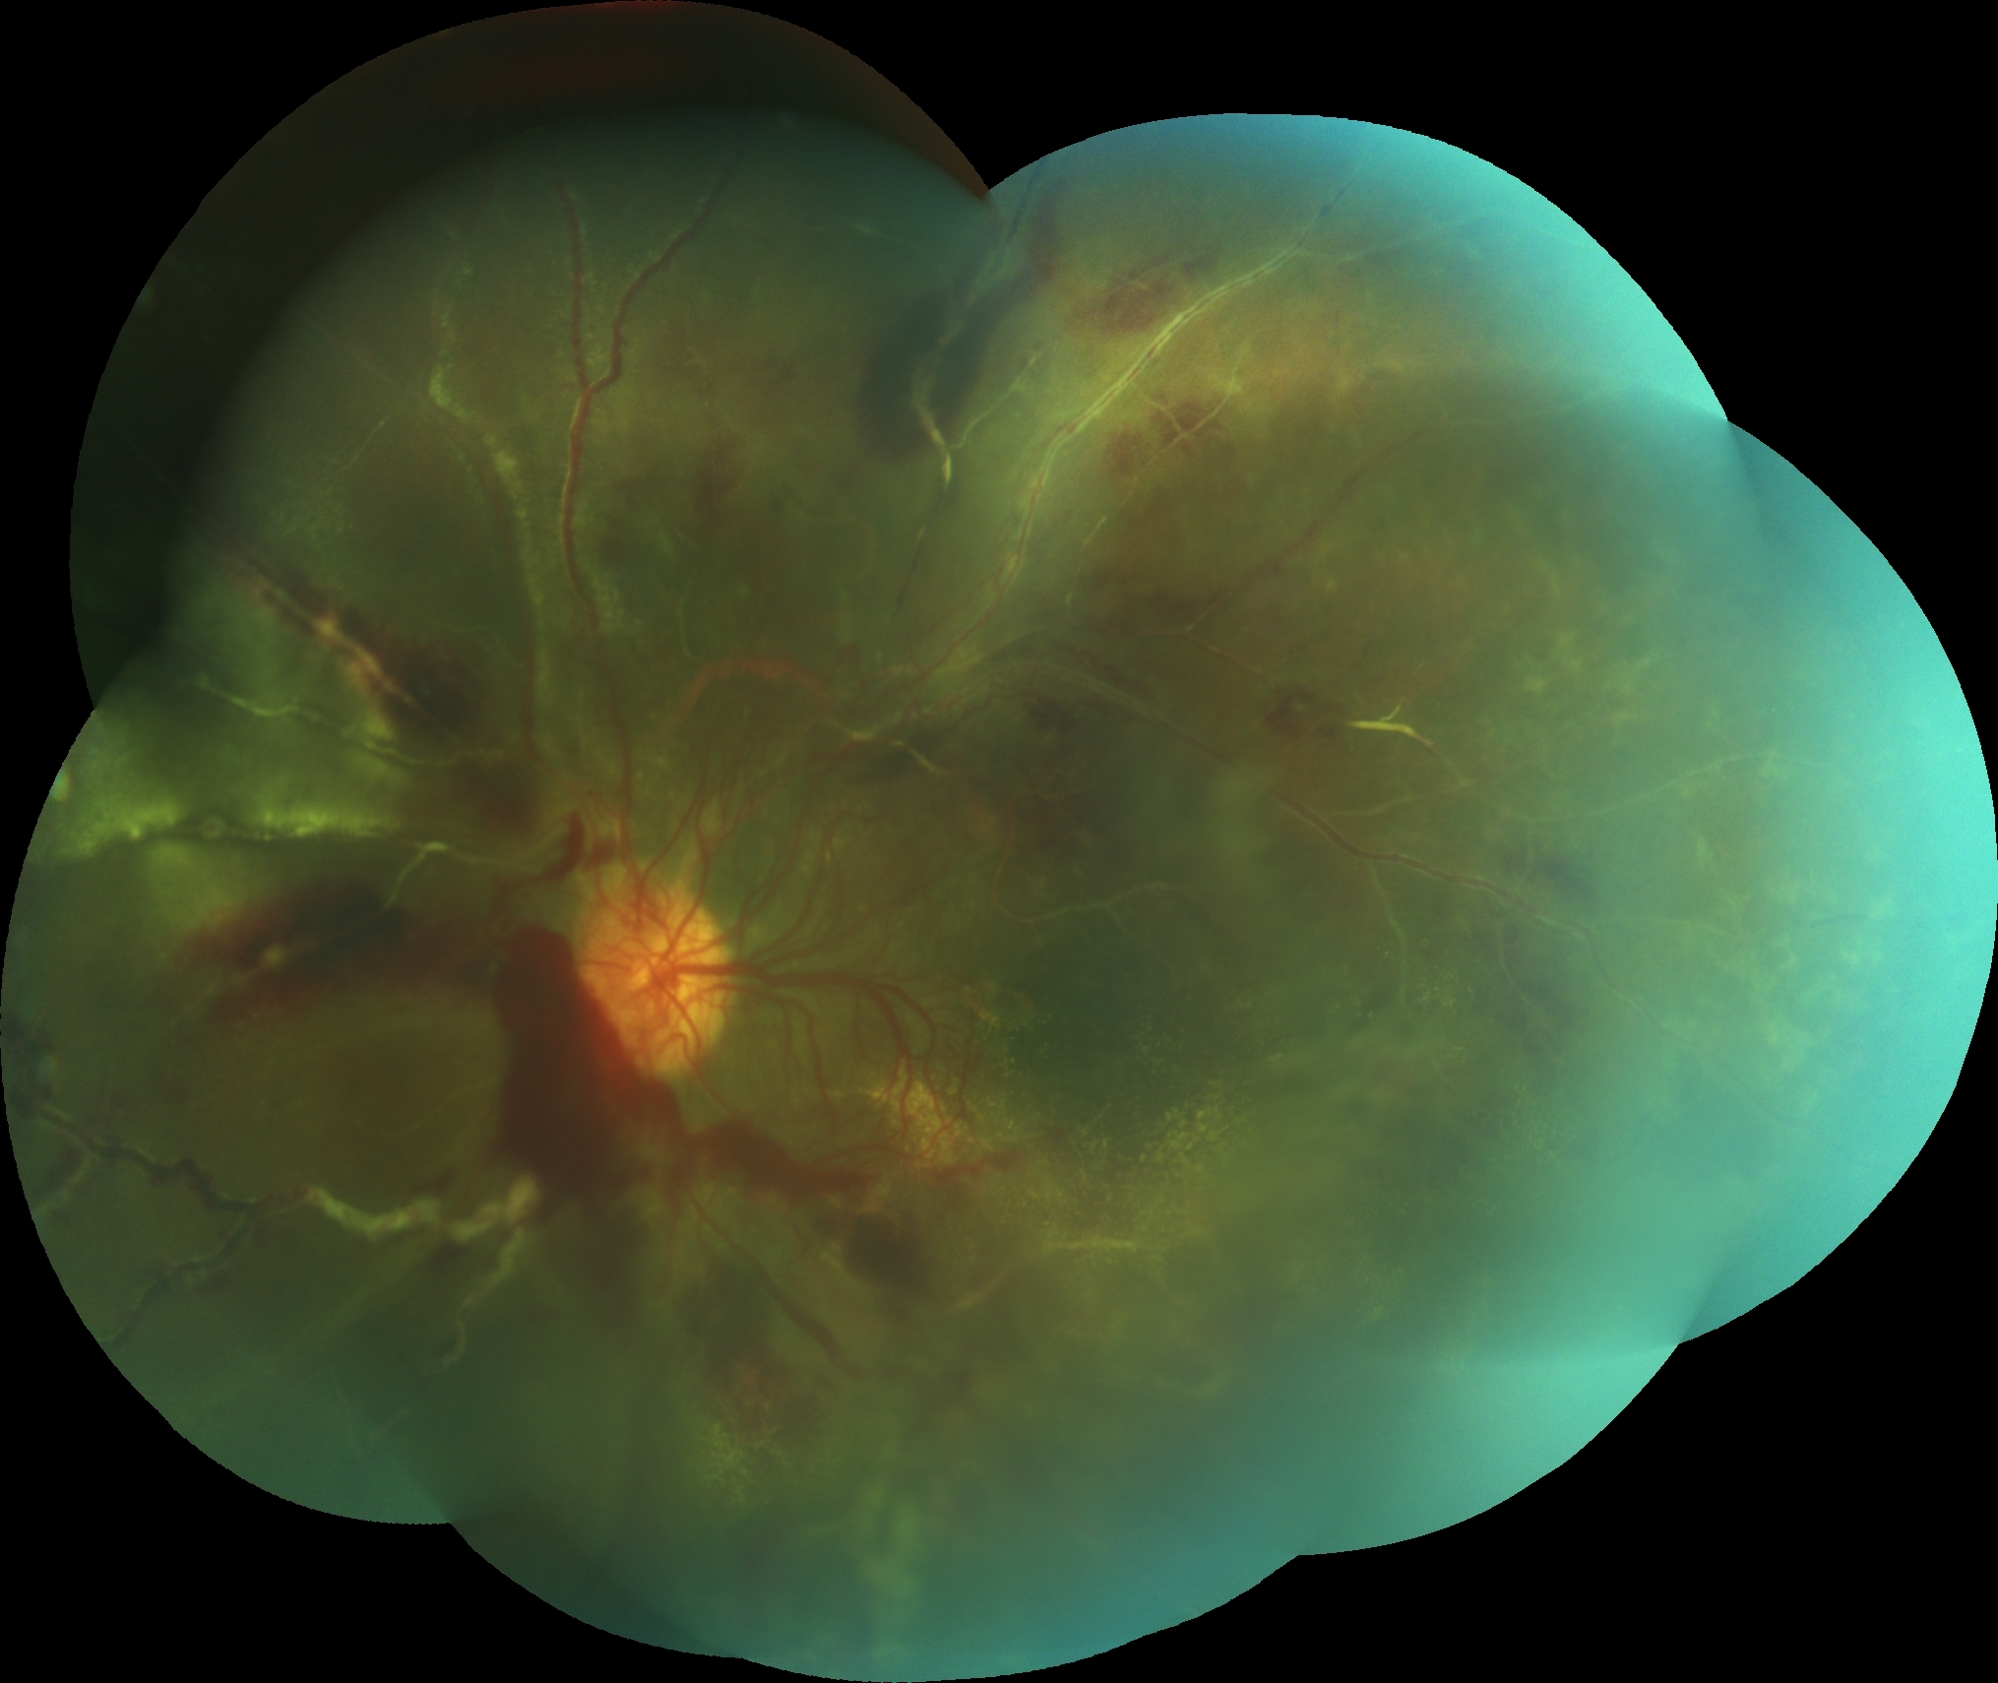

Slide 5
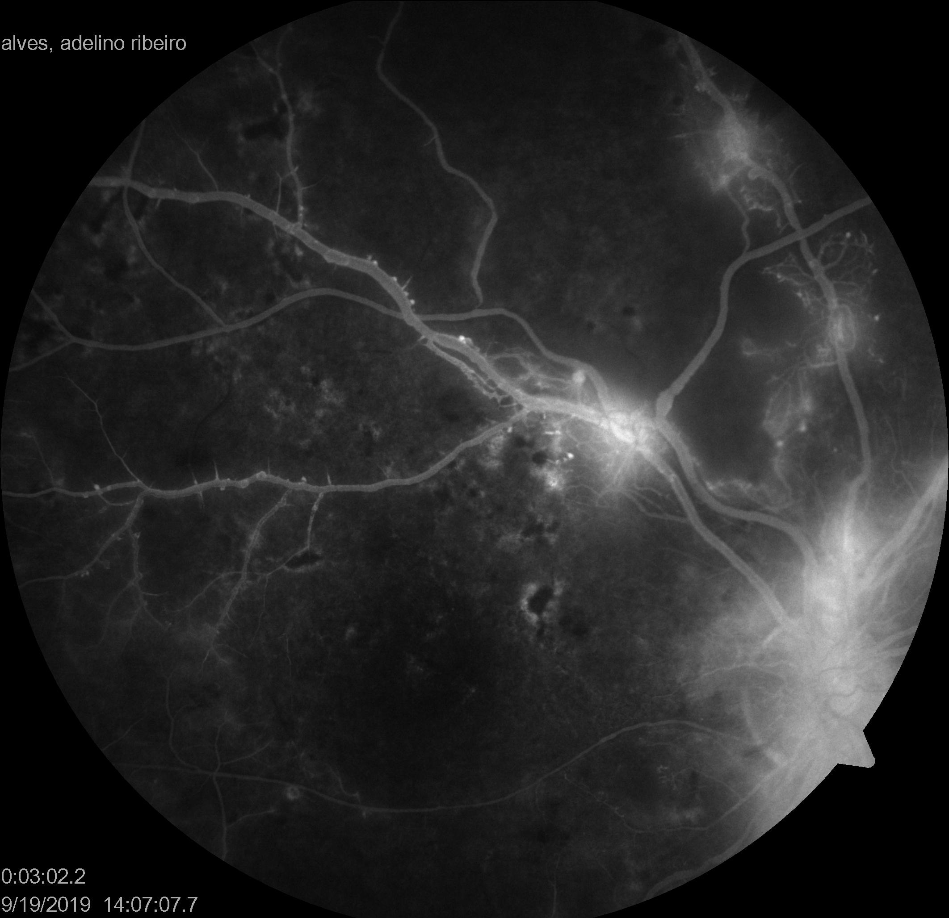
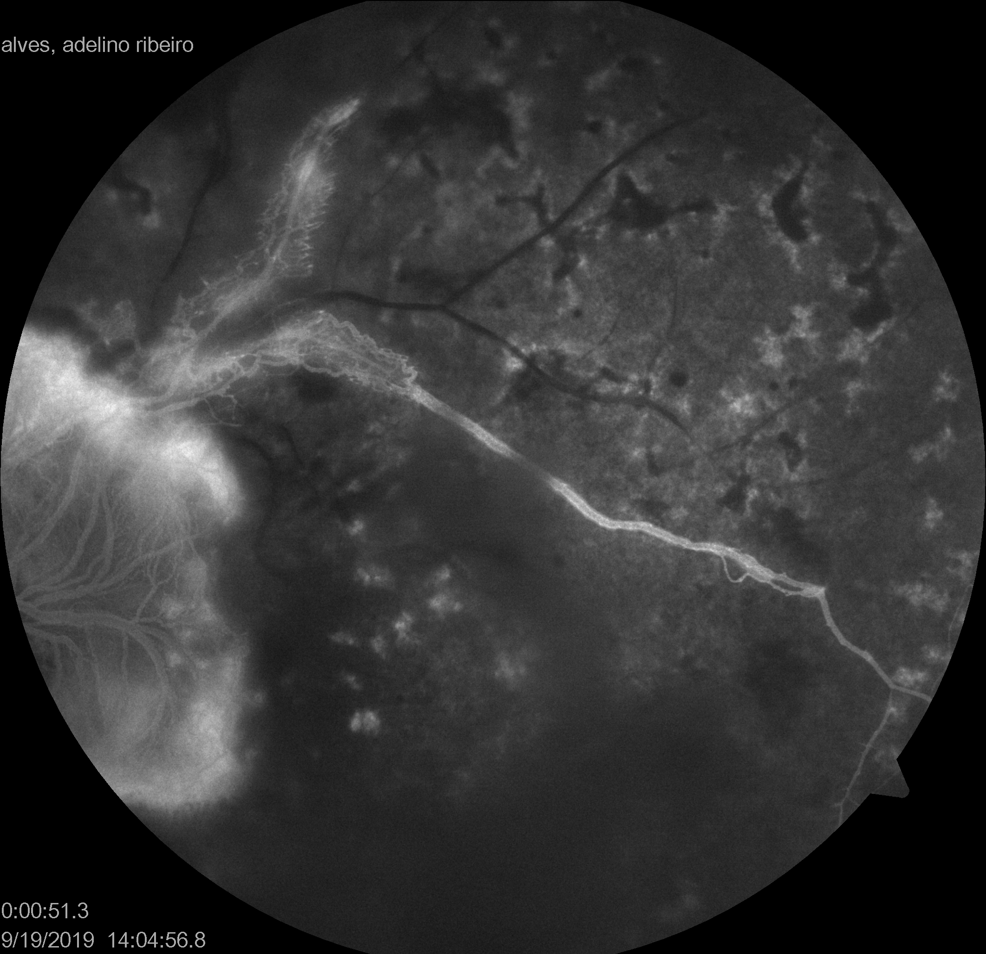

Slide 6
Diagnosis
Purstcher retinopathy complicated with retinal neovascularization.
Management
Panretinal photocoagulation.
Maintain regular follow up.

