Slide 1
Open Your Eyes for Stroke
Holanda, EC, Gasparini, MS, Neto, JJN, Huarachi, DR, Fernandes, VHR, Silva, IC, Nascimento, MA

Slide 2
Case
Female
79 years old
Scotoma in the upper right eye hemicamp
4 days of history
Denied pain or photopsies
Previous history: chronic hypertension

Slide 3
BCVA 20:40 both eyes
IOP 12 both eyes
Normal anterior segment both eyes

Slide 4
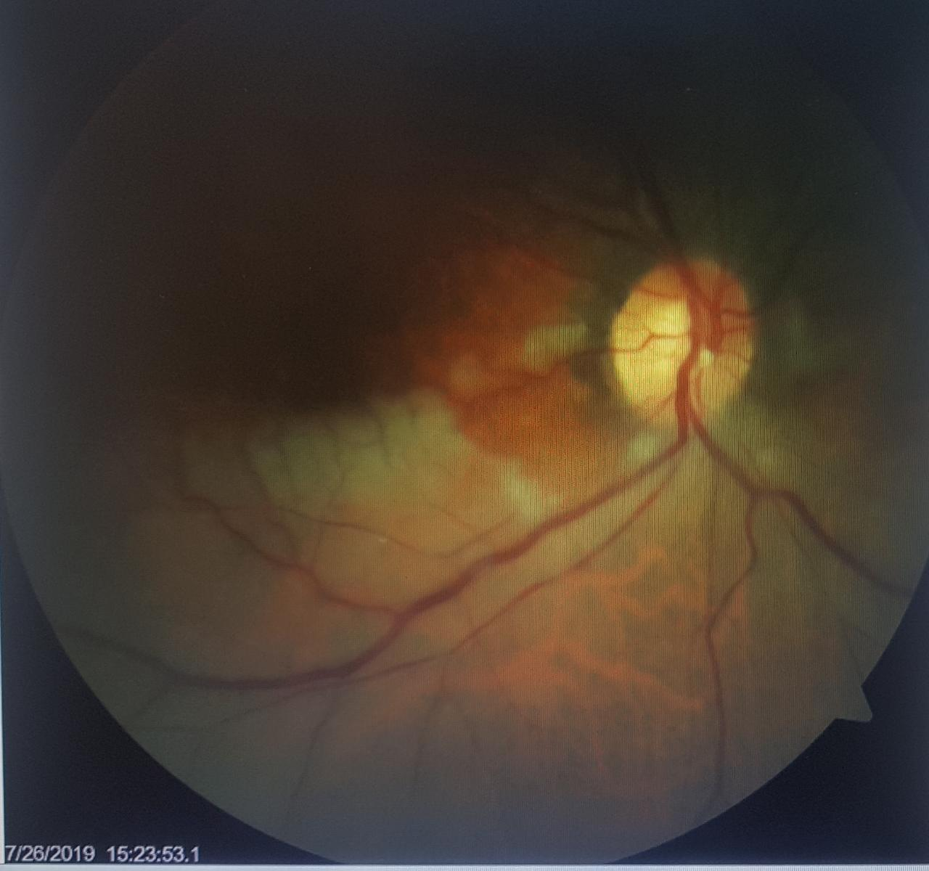

Slide 5
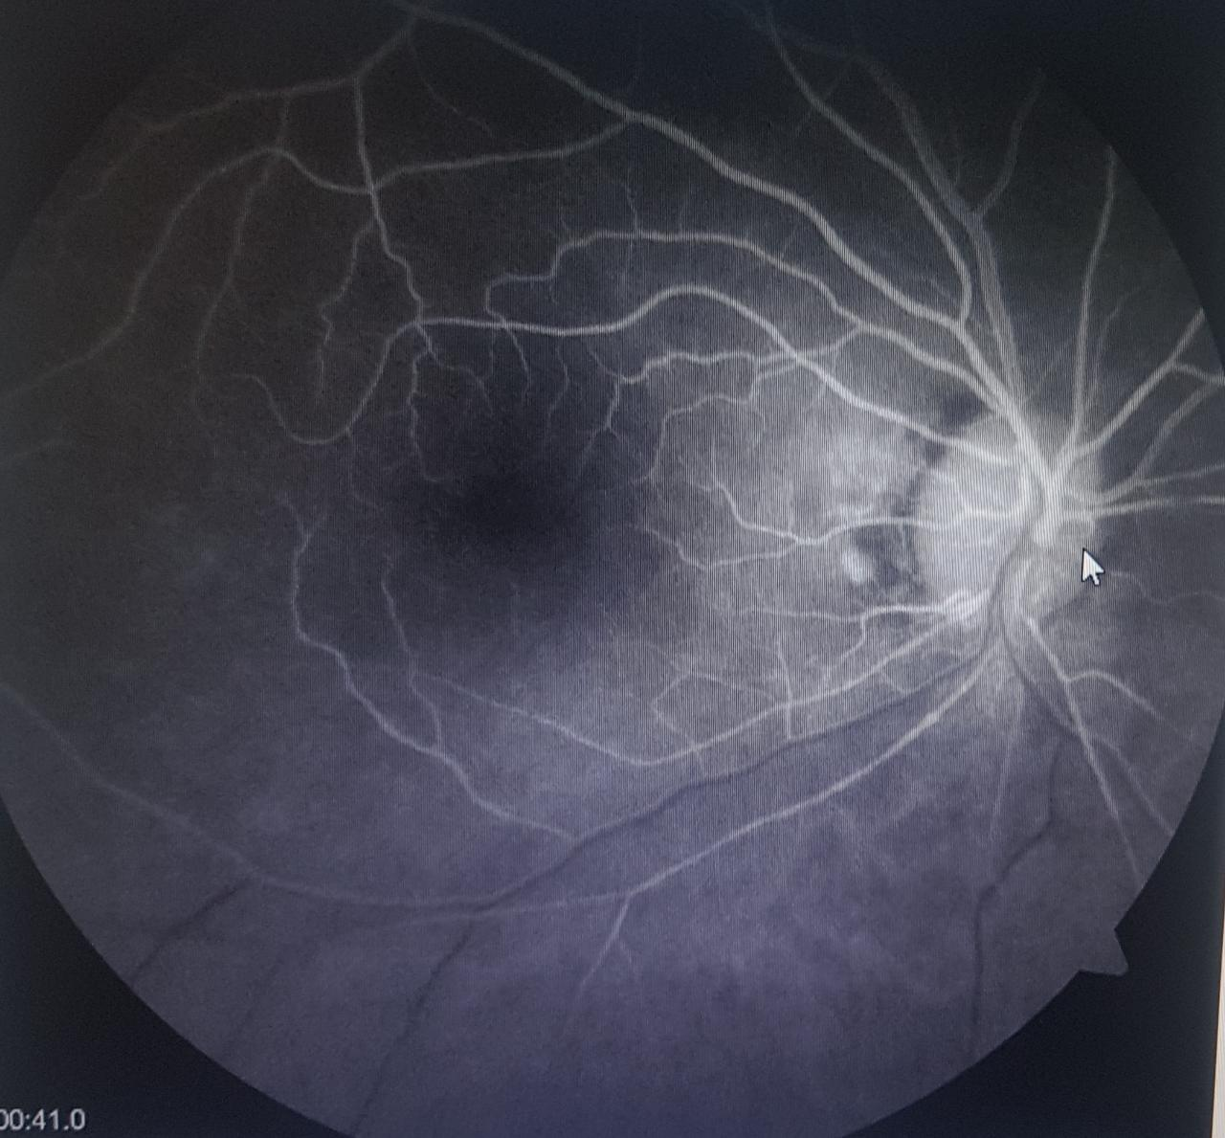

Slide 6
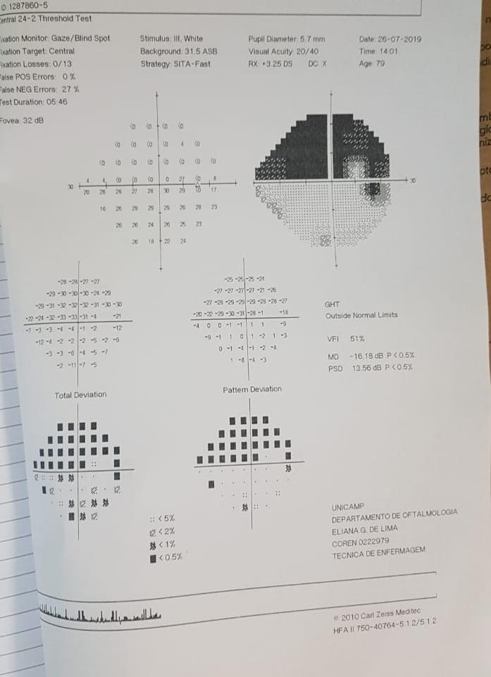

Slide 7
Decided for clinical follow-up
BCVA unchanged
No signs of neovascularization

Slide 8
Branch Retinal Artery Occlusion
Plunger or thrombus result
Cholesterol emboli
Platelet-fibrin emboli
Calcific emboli
Clinical diagnosis
Treatment
Directed toward systemic etiologic factors
No specific ocular therapy has been found to be effective in improving the visual prognosis
Hayreh SS, Podhajsky PA, Zimmerman MB. Branch retinal artery occlusion: natural history of visual outcome. Ophthalmology.
2009;116(6):1188–1194.
Wang JJ, Cugati S, Knudtson MD, et al. Retinal arteriolar emboli and long-term mortality: pooled data analysis from two older
populations. Stroke. 2006;37(7):1833–1836.

Slide 9
33 patients
24.2% was detected with acute ischemic stroke
Among these, 37.5% did not exhibit any neurologic symptoms or signs
93 relevant studies between 1992-2015
19.6-25% of chance of acute stroke

