Slide 1
RETINA START – SURGICAL CASE
Heitor do Amaral Simões

Slide 2
SURGICAL CASE
Identification - Female, white, 38 yo
Chief Complaint – Sudden, painless decreased vision in the left eye
History of Present Illness – Patient reports that his left eye was "plugged by a big fly" 4 days ago, reports that it was after a "laser point" was aimed at his eye. Also reports that the top of the objects were blurred
Past Medical History - None
Past Ocular History - No previous ocular disease history. No eye surgery, no previous eye or head trauma.

Slide 3
Ophthalmological Exam
 | OD | OE
Visual Acuity (Snellen with correction) | -1,00ˆ-1,00 165 20/20 | 20/400 Nasal
Intraocular Pressure | 15 mmhg | 12 mmhg
Pupil Examination | Reactive to light | Reactive to light
Motility | Full | Full
External Examination | Normal | Normal
Slit-lamp Examination | Lids/Lashes: Normal Conjunctiva/Sclera: Clear and quiet Cornea: Clear Anterior Chamber: Deep and quiet Iris: Normal architecture Lens: Clear Vitreous: Normal | Lids/Lashes: Normal Conjunctiva/Sclera: Clear and quiet Cornea: Clear Anterior Chamber: Deep and quiet Iris: Normal architecture Lens: Clear Vitreous: Normal
Fundus Examination

Slide 4
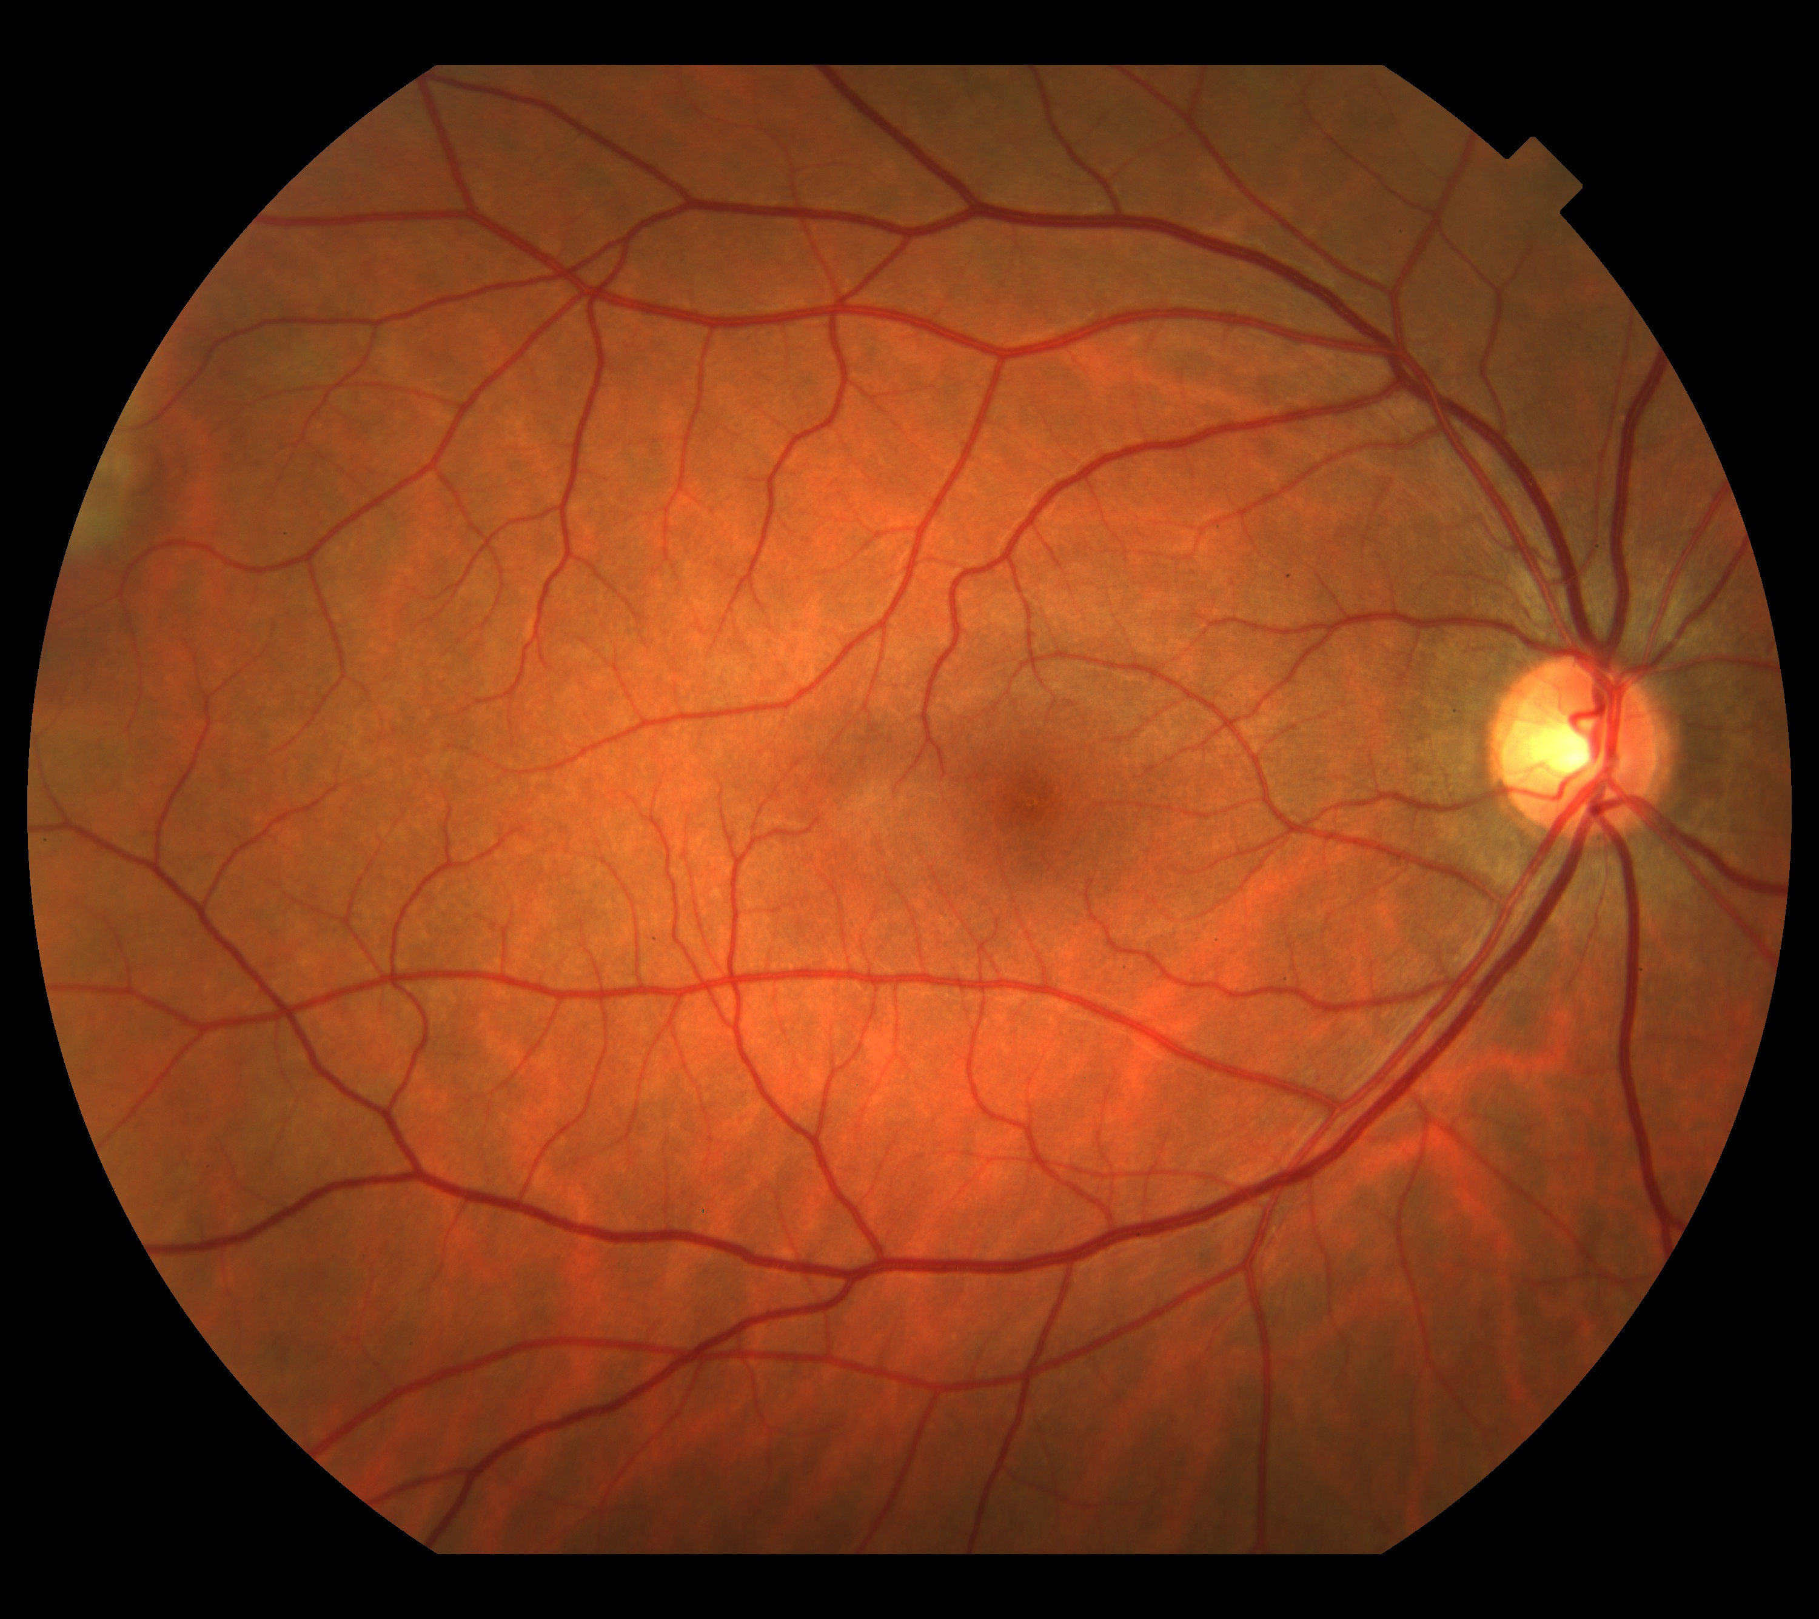
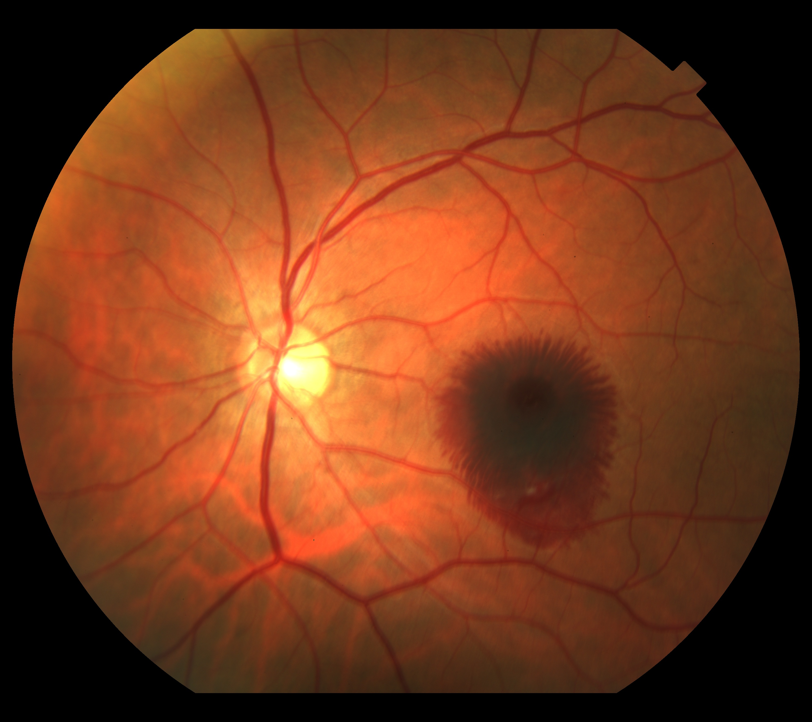

Slide 5
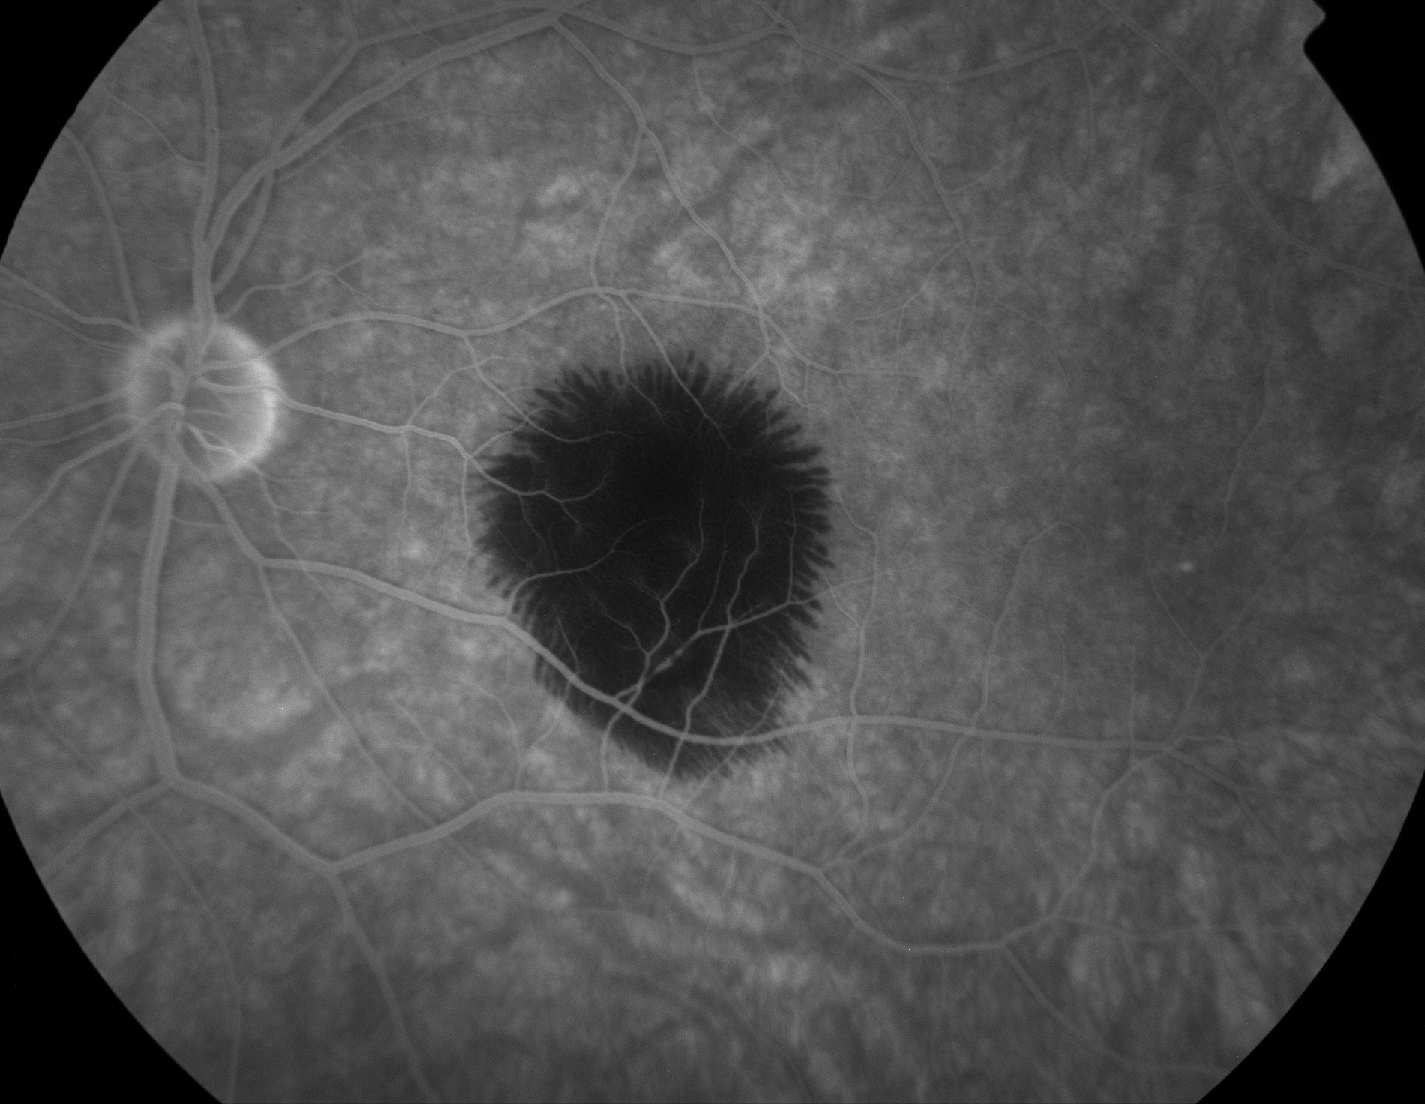

Slide 6
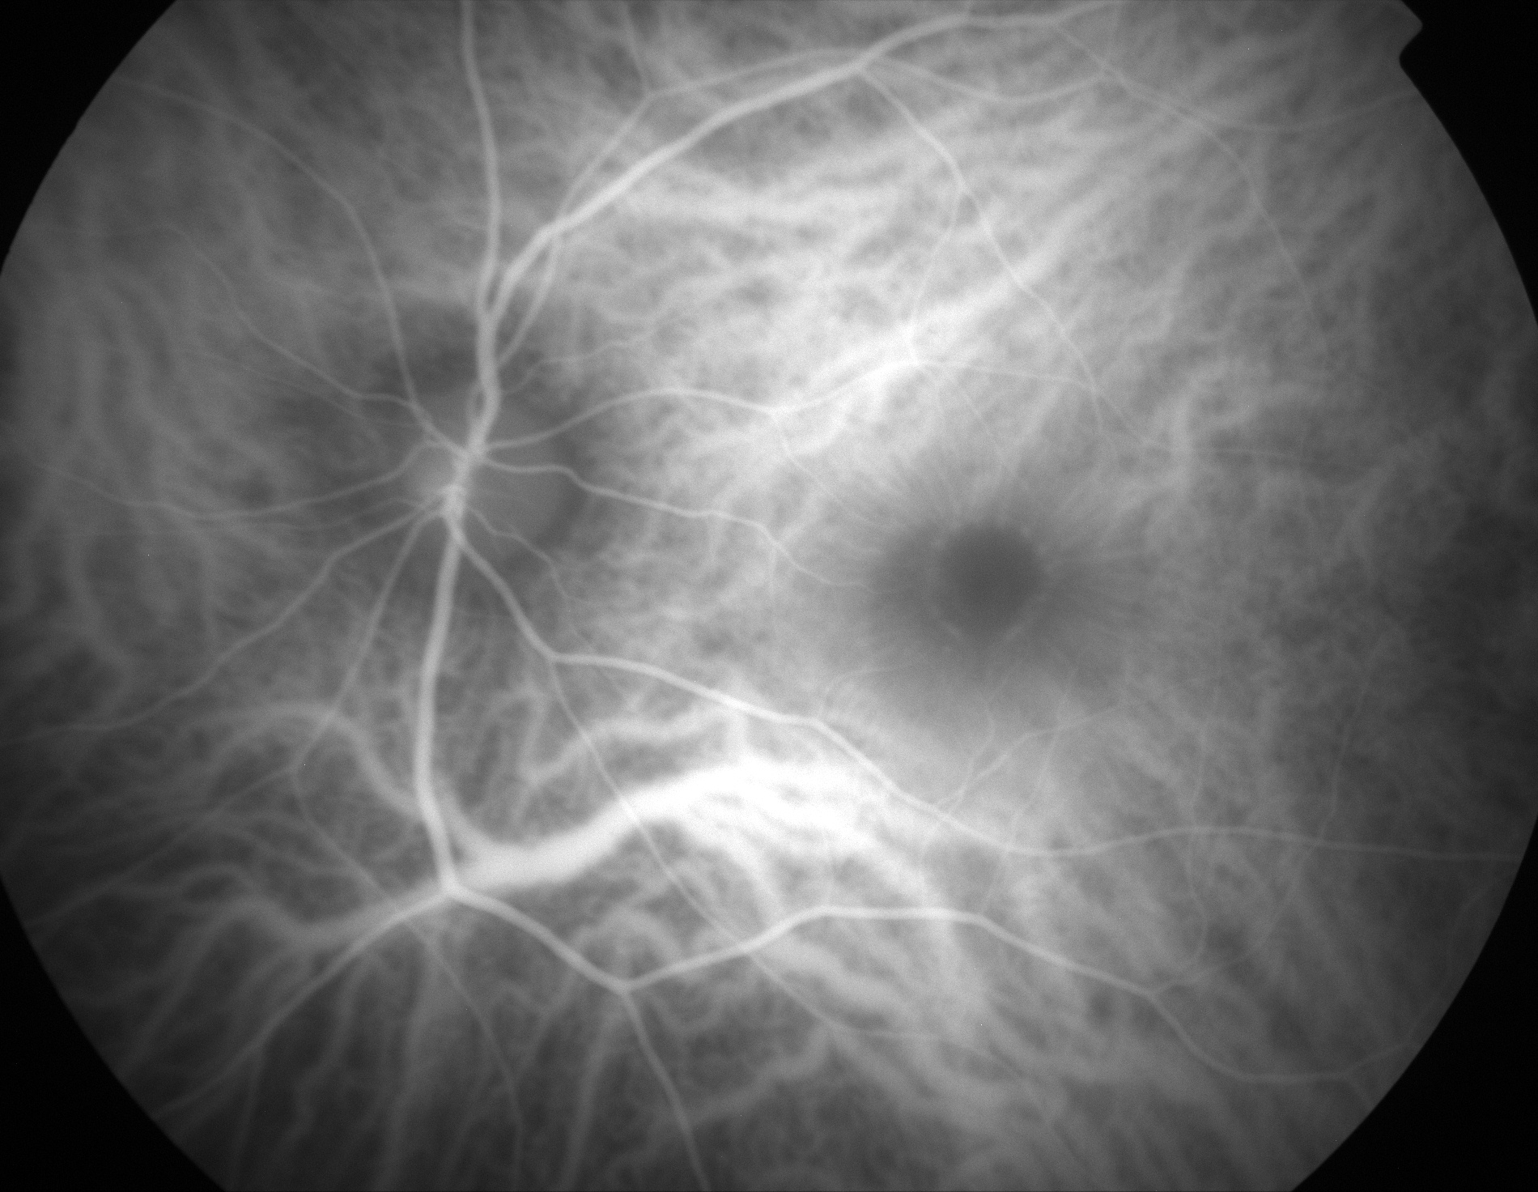

Slide 7
oct

Slide 8
Sub-foveomacular Hemorrhage After Laser Pointer Induced Injury
Treatment:
Intravitreal 0.4cc of SF6
Prone positioning

Slide 9
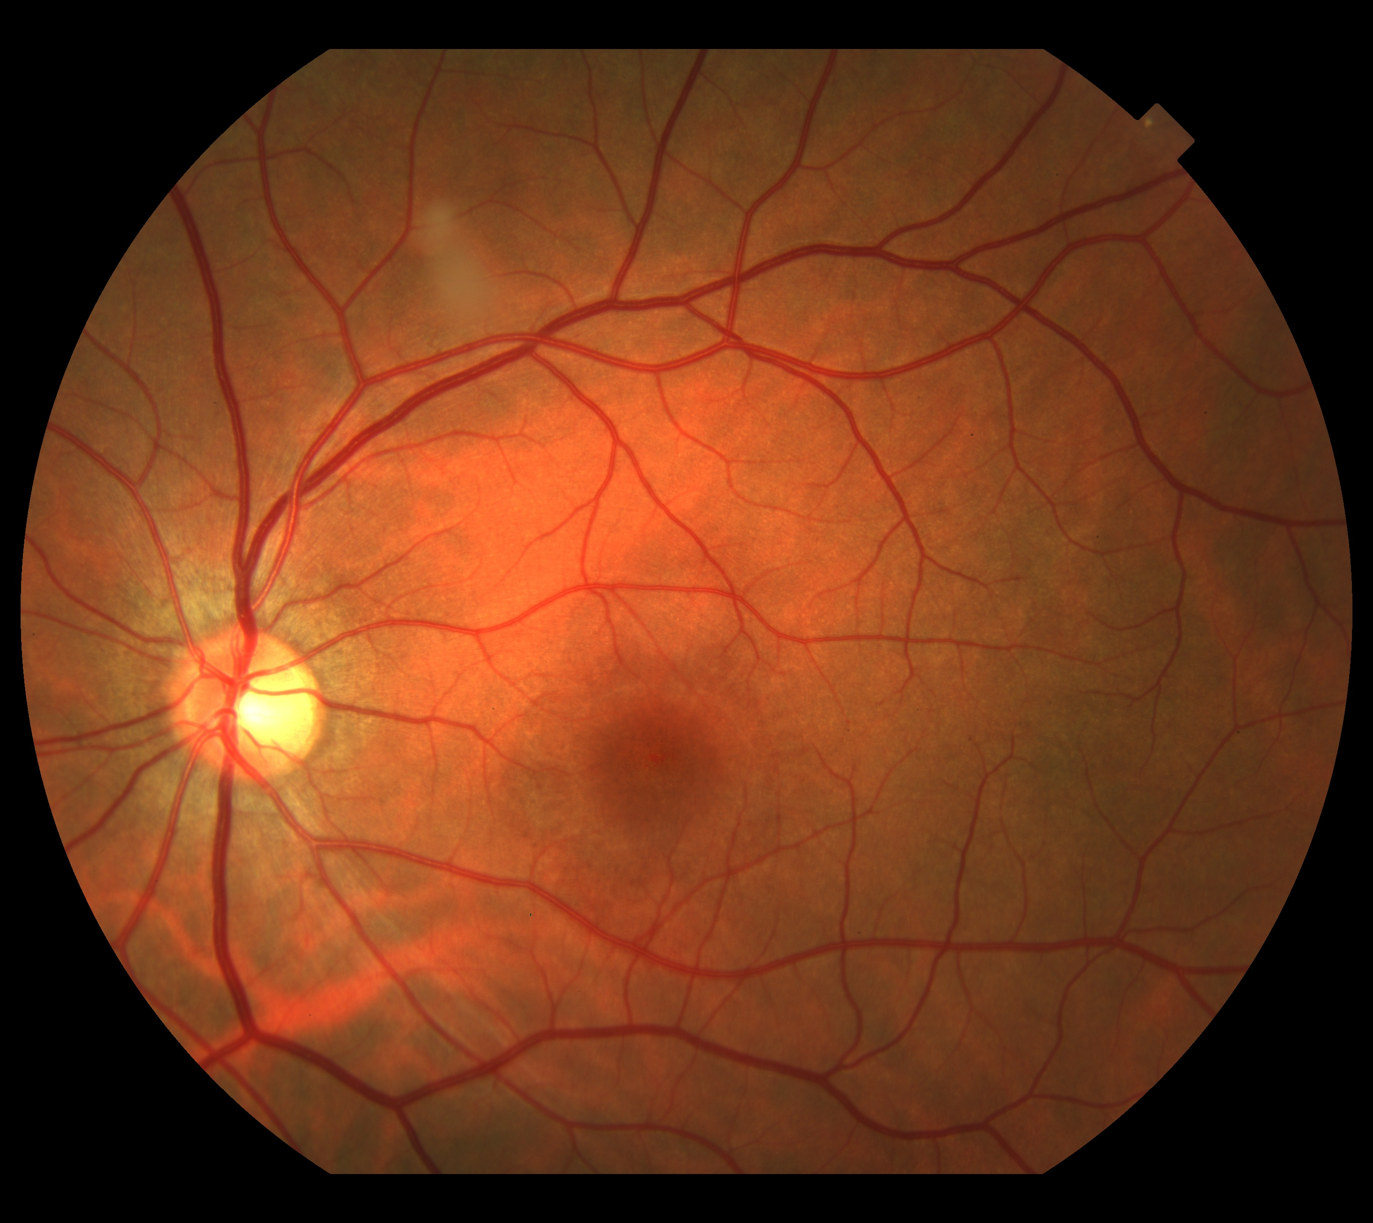
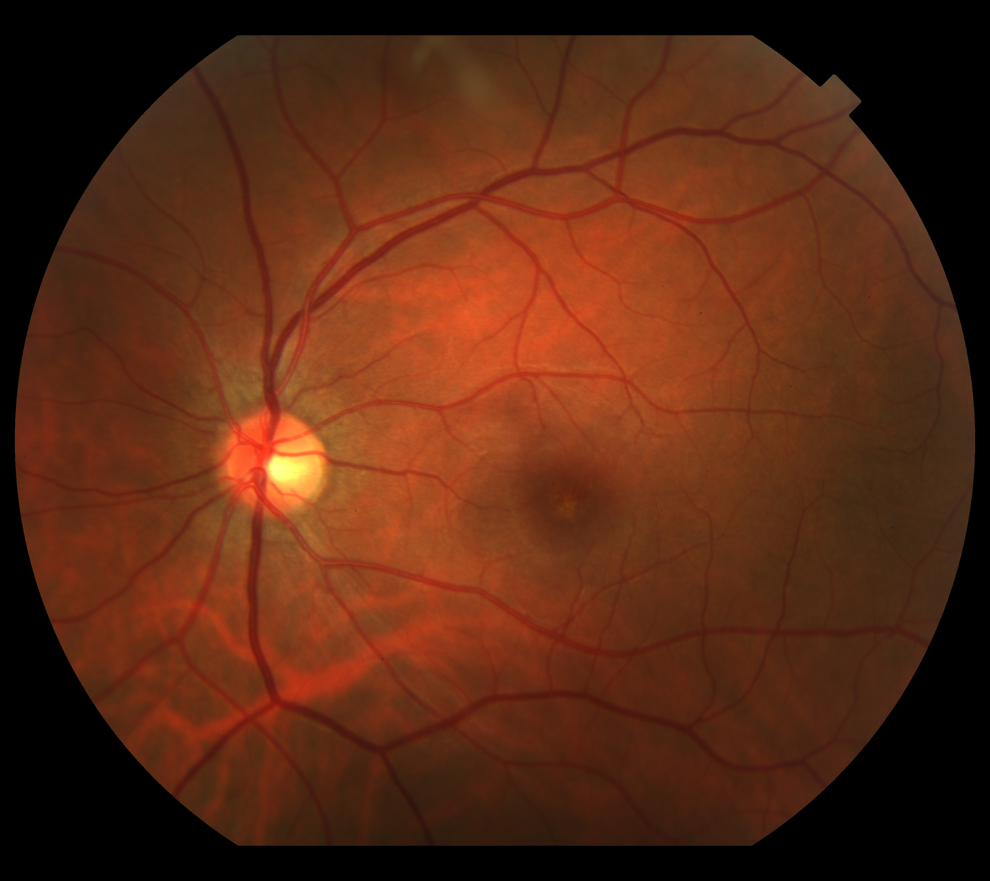
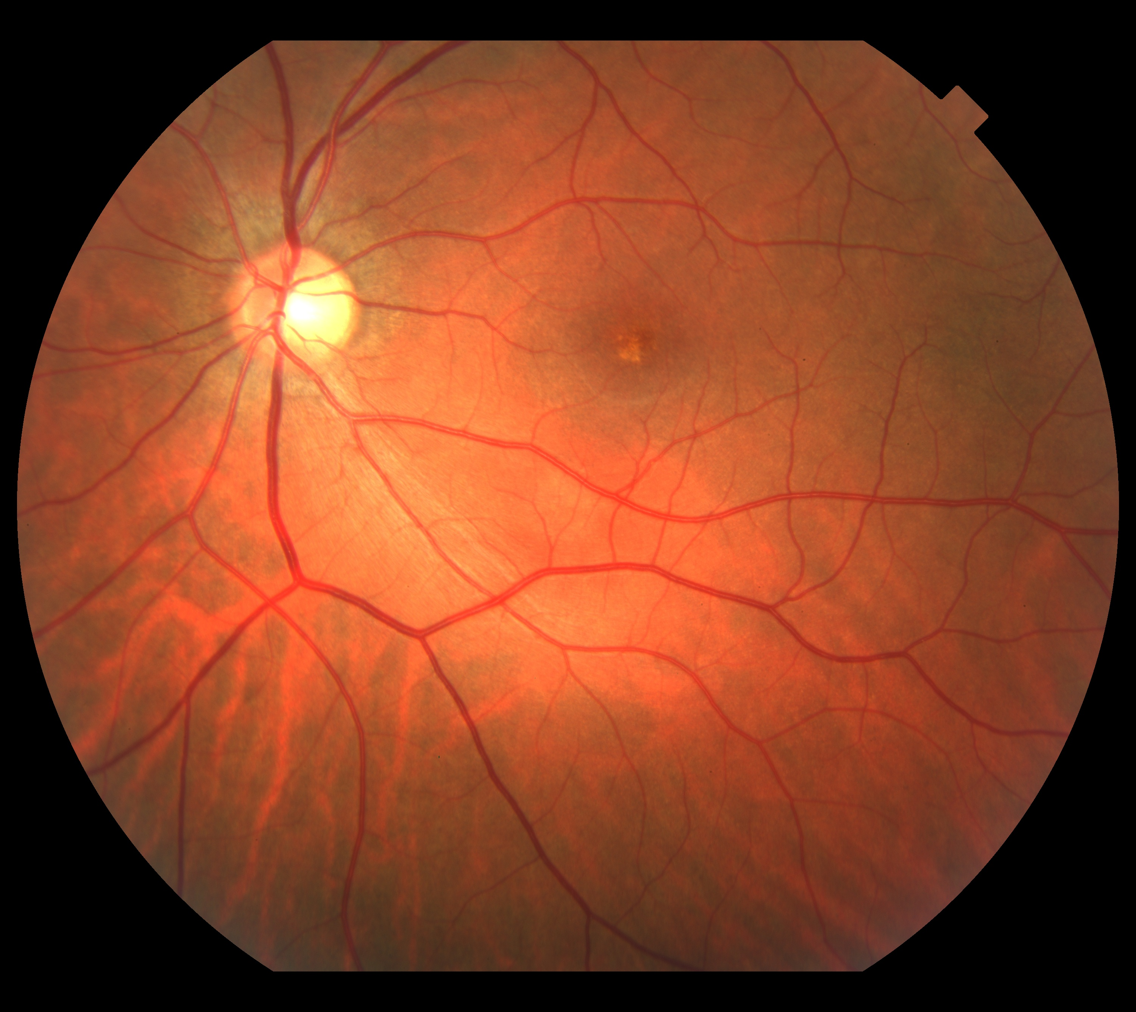
06/10/09
08/03/10
07/11/11
-1,00ˆ-0,50x45 20/70

Slide 10
-1,00ˆ-0,75x30 20/25
Notes:
21/08/2017 refra + FO + OCT

Slide 11
Obrigado!
hamaralsimoes@hotmail.com

