Slide 1
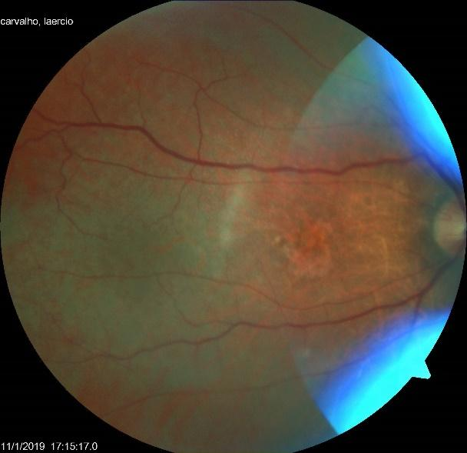
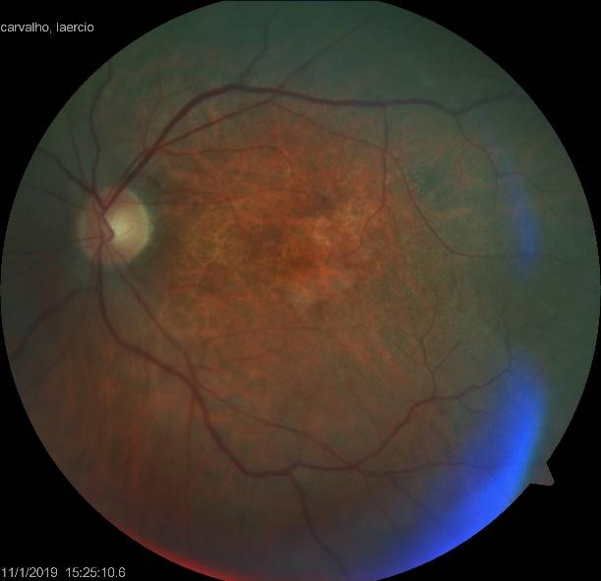
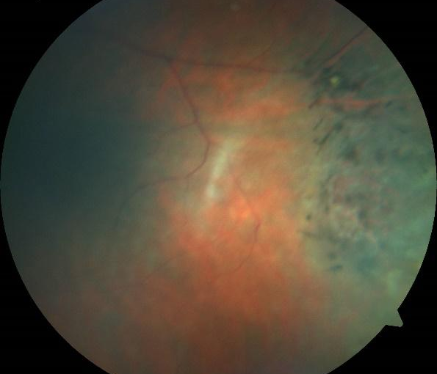
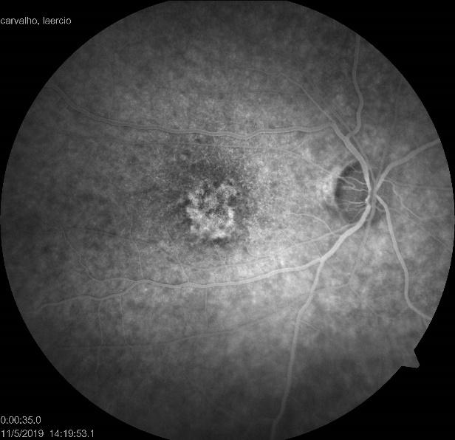
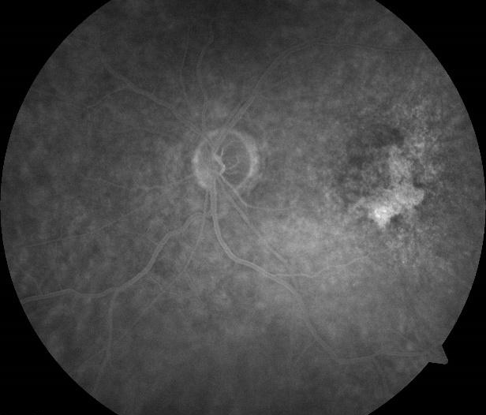
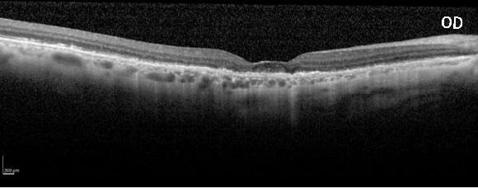
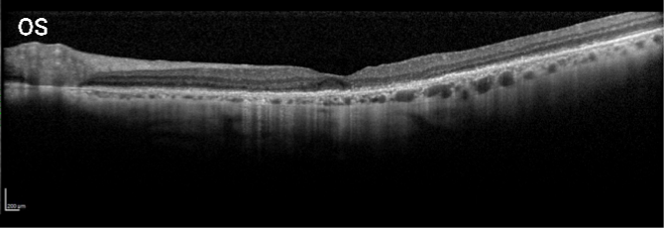
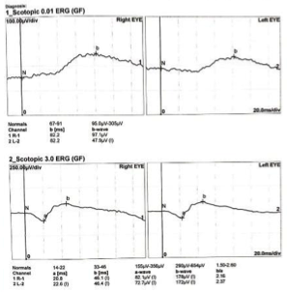
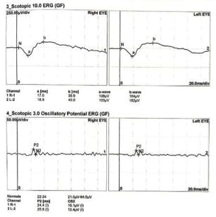
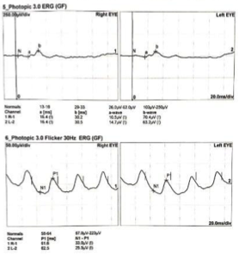
Retinal Toxicity Secondary to HAART: CASE REPORT
Vicente Hidalgo R. Fernandes; Luísa G. Gross; Arthur P. Favarato; Delma R. G. Huarachi; Iuri C. Silva; Erick C. Holanda; Maurício A. Nascimento; Andrea M. S. Torigoe
vicentehidalgof@gmail.com
DEPARTMENT OF OPHTHALMOLOGY OF THE UNIVERSIDADE ESTADUAL DE CAMPINAS (UNICAMP) – SÃO PAULO, BRAZIL
OBJECTIVE
We present a case of retinal toxicity secondary to HAART (highly active antiretroviral therapy).
DISCUSSION
Among the main causes of retinopathies in HIV patients are the infections causes, either because of an opportunist disease or by the HIV itself. Once the patient in question had a good control of the disease, the toxic causes should be considered. A case report in literature describes RPE and cones changes in ERG secondary to efavirenz that were present in our patient. Although, there are 9 case reports about retinal ritonavir toxicity. Some of the findings in this retinopathy stand out the efavirenz toxicity, such as pigmentary changes in the macula, decrease in retinal thickness, loss of ellipsoid zone integrity as well as bone-spicule in the periferical retina.
OD
OS
OS
CASE REPORT
Male, 60 years, was admitted at HC-UNICAMP ophthalmology ER with 1-year onset low visual acuity (VA) in both eyes. Hypertensive and HIV positive, currently in use of tenofovir, lamivudine (3TC) and efavirenz, maintaining good HIV control and negative sorologies. During 2011 and 2014 made use of zidovudine, 3TC and atazanavir/ritonavir, which were replaced afterwards. Presented counting fingers VA. Fundus examination showed granular pigmentary changes in the macula, diffuse intrarretinal crystalline deposits and bone-spicule lesions in the supero-temporal region in the left eye. OCT showed in both eyes thinning of the retinal thickness, disorganization of the outer retina, discontinuity of the ellipsoid zone and retinal pigment epithelium (RPE) and diffuse tapering of choroidal thickness that was thinner nasal to the fovea. Fluorescence Angiography resulted in hyperfluorescence by window defect and granular hypofluorescent pattern in the macula of both eyes. Electroretinogram (ERG) observed cones and amacrine cells disfunciton in both eyes and rods disfunction in the left eye.
OD
OS
CONCLUSION
In summary, this reinforces the importance of ophthalmologic follow up of these patients with macular OCT and ERG, objectifying the early diagnosis and suspension of these agents in the first sign of toxicity present.
BIBLIOGRAPHY
1. Louie AK, Jones HN. Retinal Toxicity Secondary to Ritonavir. Optometry and Vision Science, 2019; 96(5):376–381.
2. Curi AL, Freeman G, Kapembwa M, et al. Retinal Toxicity Due to Efavirenz. Eye (Lond) 2001;15(Pt 2):246–8.
OD

