Slide 1
RETINA START Clinical Case
Igor Coêlho – fellow from SBRV accredited service

Slide 2
Clinical Case
Child, 6- month-old, female
Nystagmus and difficulty following objects
Twin pregnancy delivered by cesarean section.
Born at 37 weeks of gestational age , with 2,130 kg birth weight.
 | Right Eye | Left Eye
Light stimulus | Difficulty following the light | Difficulty following the light
Tonometry | 14 mmHg | 14mmHg
Anterior Segment Biomicroscopy | Unremarkable | Unremarkable

Slide 3
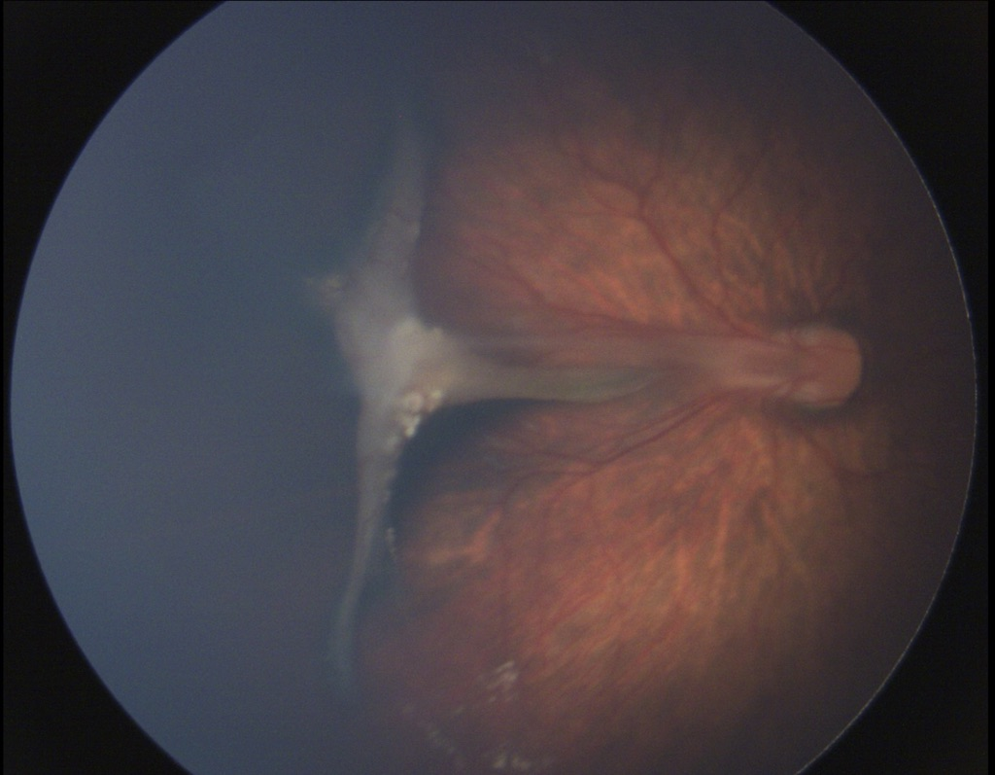
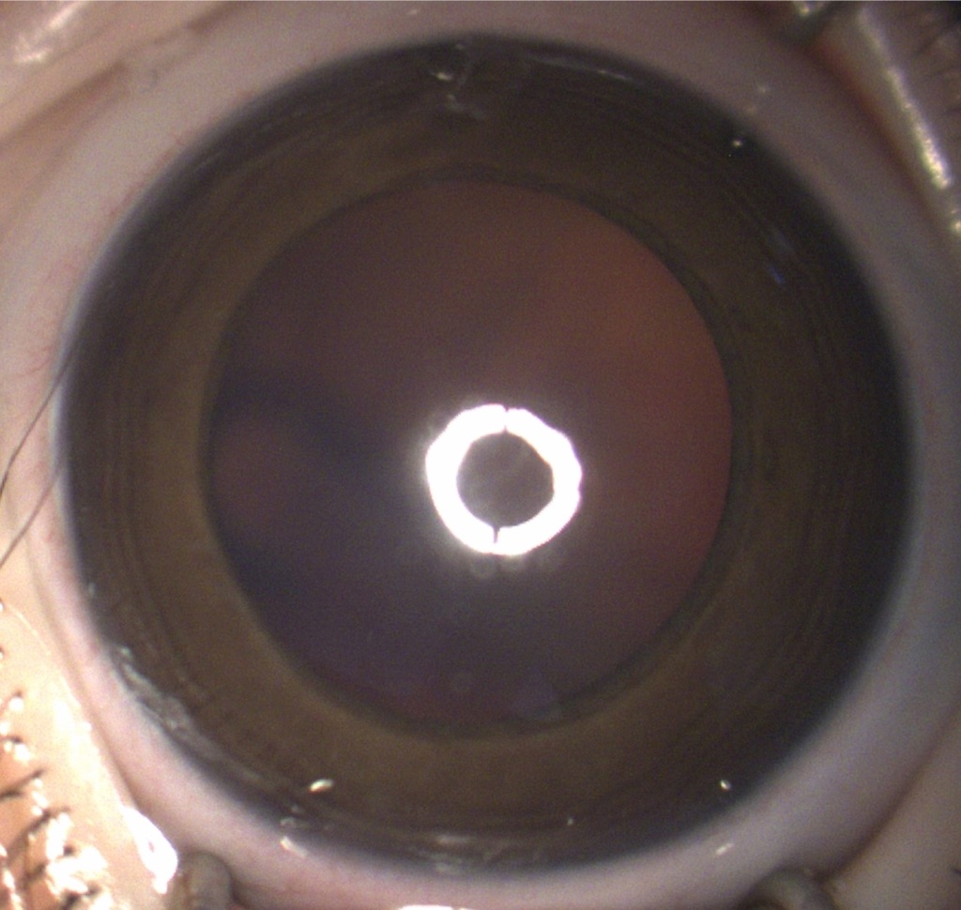
Right Eye
Anterior segment
Fundoscopy

Slide 4
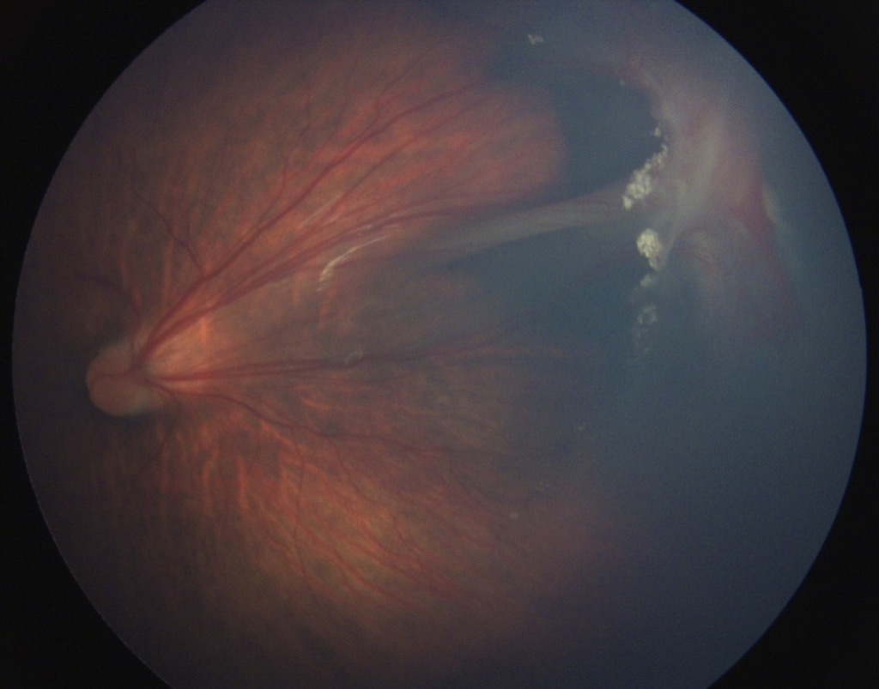
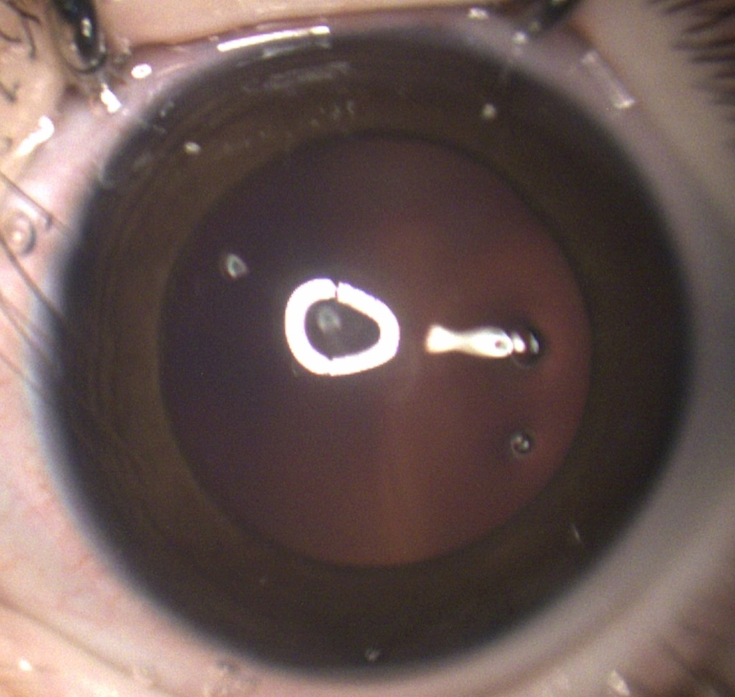
Left Eye
Anterior segment
Fundoscopy

Slide 5
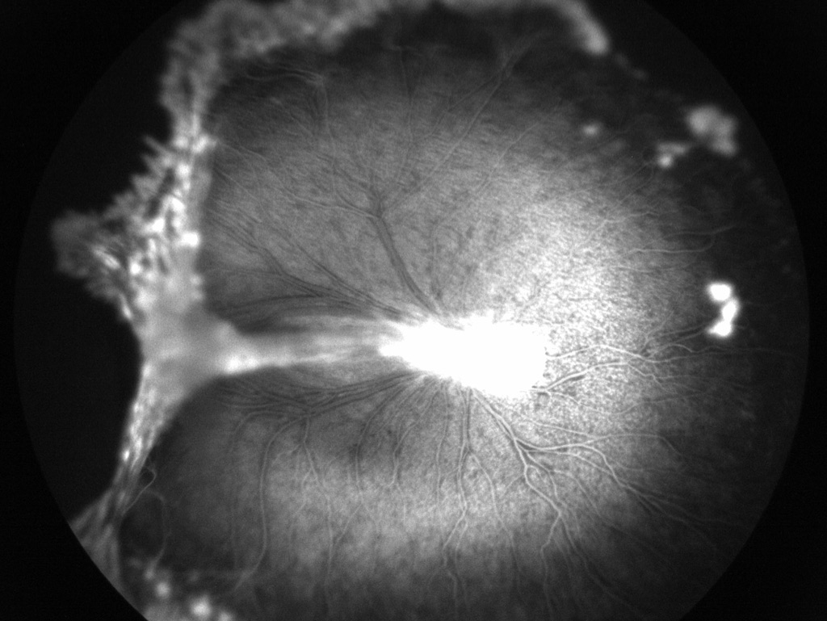
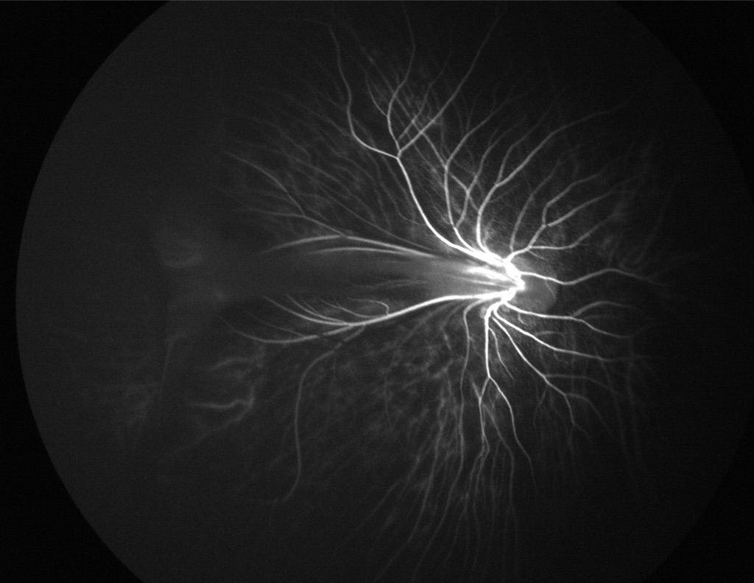
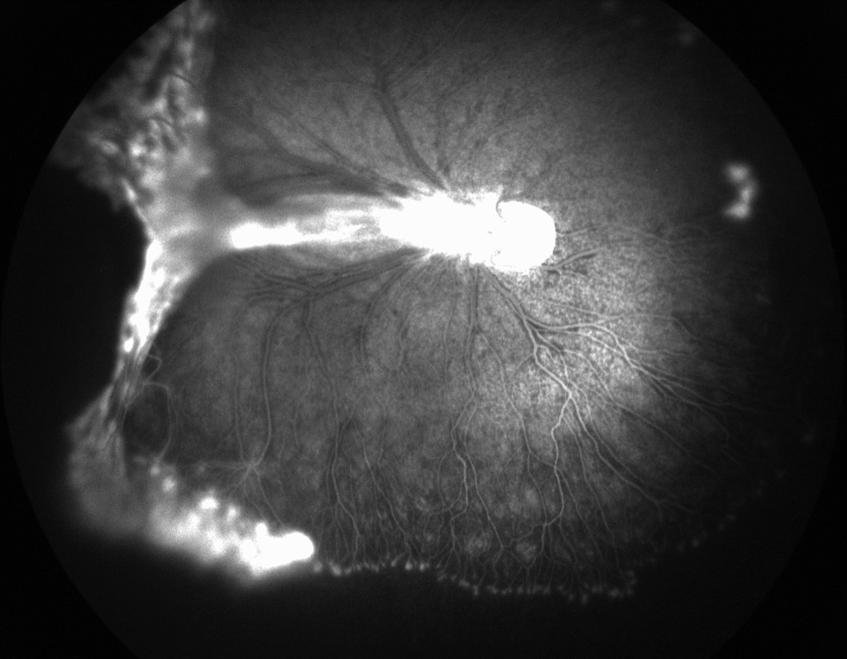
Right Eye – Fluorescein Angiography

Slide 6
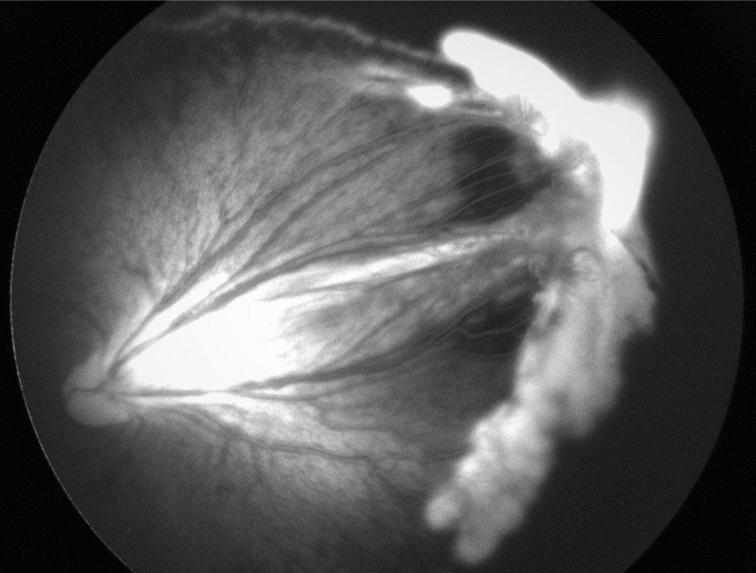
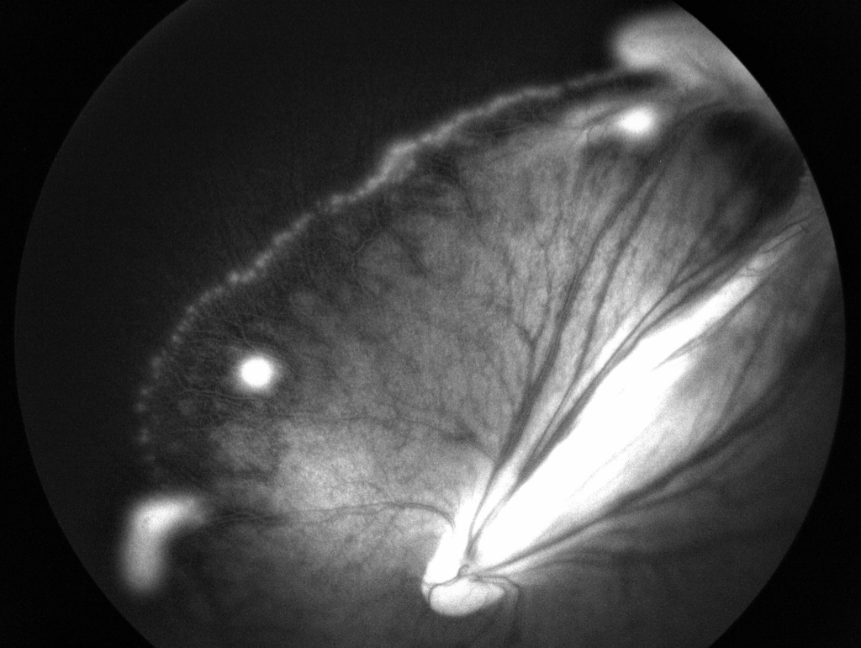
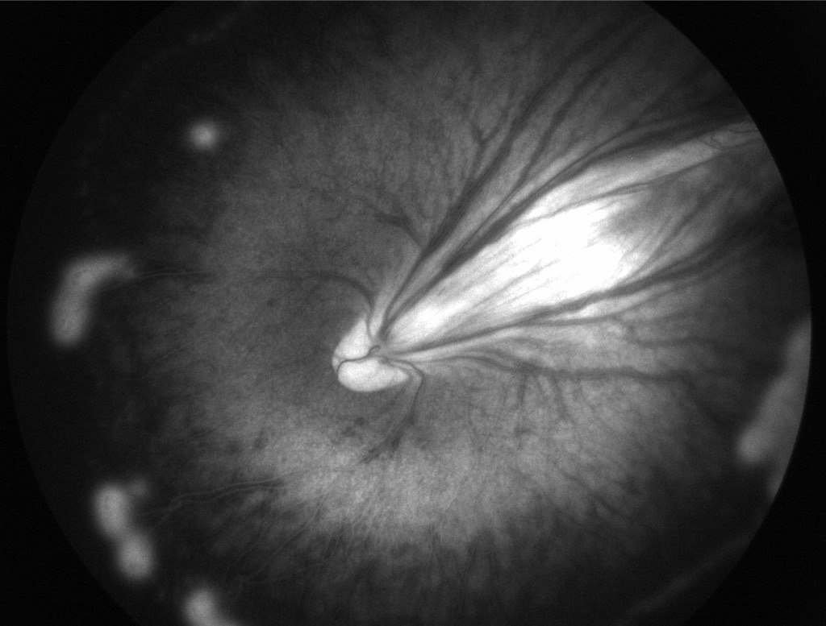
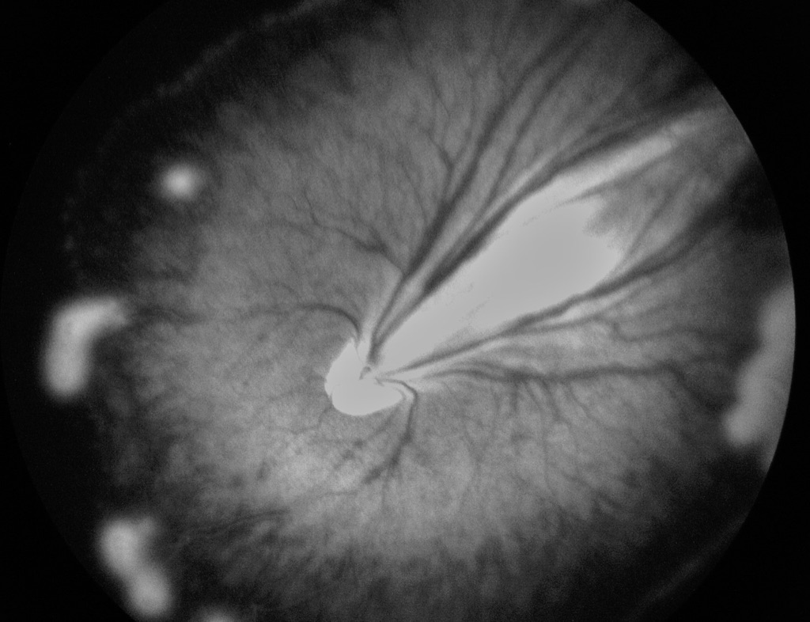
Left Eye – Fluorescein Angiography

Slide 7
Clinical Case
Differential diagnosis
Familial exudative vitreoretinopathy (FEVR)
Retinopathy of prematurity (ROP)
Persistent hyperplastic primary vitreous (PHVP)
Management ???

