Slide 1

CLINICAL CASE
Lucas De Angelis Rubira
Ophthalmologist from Sadalla Amin Ghanem Eye Hospital – Joinville/SC – Brazil

Slide 2
Case Report: Occult Macular Dystrophy- multimodal analysis

Slide 3
Clinical Case
A 39-year-old healthy woman complaining of progressive and slowly vision impairment in both eyes since 2002 with onset after a refractive surgery.
BCVA: OD: 20/150 and OS: 20/150
Biomicroscopy: normal.

Slide 4
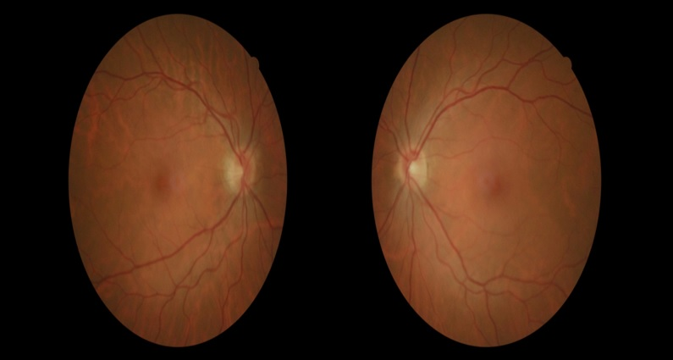
Notes:
Indirect fundus ophthalmoscopy didnt revealed any abnormalitie in both eyes

Slide 5
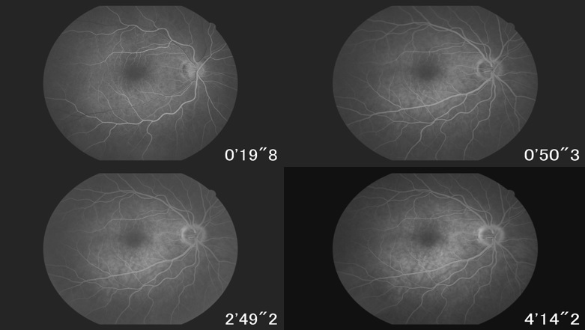
Notes:
Fluorescein angiography did not show any sign of staining, leakage or window defect ir her righ eye

Slide 6
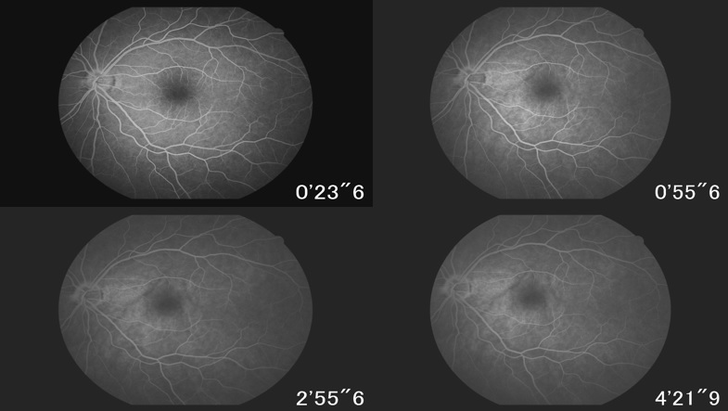
Notes:
Fluorescein angiography did not show any sign of staining, leakage or window defect ir her left eye too

Slide 7
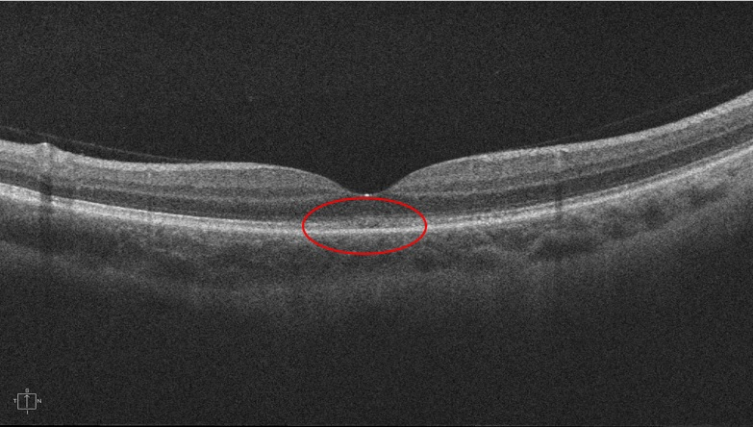
Notes:
OCT showed a subtle disruption in the COST zone in subfoveal área on her right eye

Slide 8
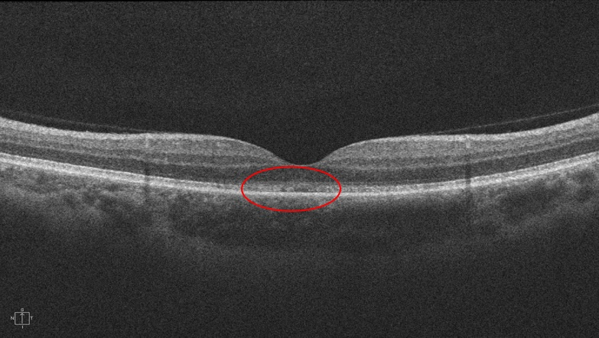
Notes:
OCT showed a subtle disruption in the COST zone in subfoveal área on her left eye too.
Comparing the two OCT we see a very similar and subtle defect In both eyes

Slide 9
1 degree (major stimulus)
Classification
AO
Binocular
Reduced amplitude
OD
Right Eye
Reduced amplitude
OE
Left Eye
Reduced amplitude
Notes:
The 1 degree visual evoked potential showed that “reduced amplitude for the major stimulus) in both eyes and in comparative too

Slide 10
15 minutes (minor stimulus)
AO
Classification
Binocular
Normal
OD
Right Eye
Normal
OE
Left Eye
Normal
Notes:
And the 15 minutes visual evoked potential showed that “normal amplitude for the minor stimulus) in both eyes and in comparative too

Slide 11
Notes:
Multifocal ERG shown moderate reduction of retinal function from 0 to 10 degrees of retinal eccentricity and within normal range in other areas (15 to 25 degrees)

Slide 12
Notes:
And in her left eye the Multifocal ERG shown moderate reduction of retinal function from 0 to 10 degrees of retinal eccentricity and within normal range in other areas (15 to 25 degrees) too

Slide 13
Take home messages
Occult Macular Dystrophy is a Choroidal osteoma is a benign tumor, with typical findings on complementary exams
It may evolve with choroidal neovascularization → reduced visual acuity.
Attention should be paid to this complication because anti-VEGF treatment can ensure satisfactory visual acuity.

Slide 14
Take home messages
Occult macular dystrophy is a rare and difficult to presume and diagnose due to a lack fundus abnormalities even in the multimodal analysis
The RP1L11 gene mutations have been described associated to the onset of the disease but some sporadic cases have been seen with similar patterns and phenotype
Attention should be paid in patients with long term complainings and a previous examinations because the lack of familiarity of ophthalmologists combined with the rarity and difficult diagnose of this condition may corroborate with misdiagnose of these patients, even ranking they like simulators
Notes:
Deve-se ter em mente a existência desta entidade, pois muitas vezes pela falta de conhecimento da mesma, alguns pacientes podem ser rotulados como simuladores e pode-se deixar de oferecer o acompanhamento adequado ao paciente e aos familiares.

