Slide 1
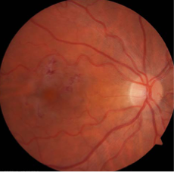
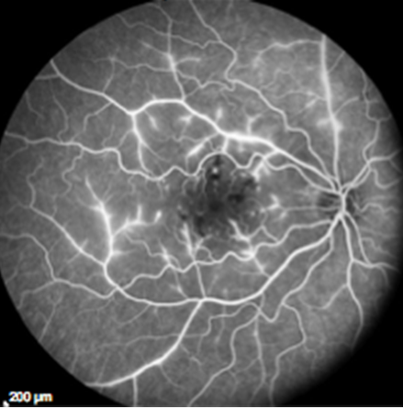
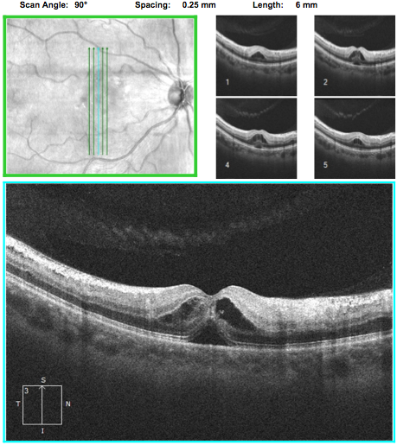
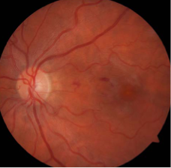
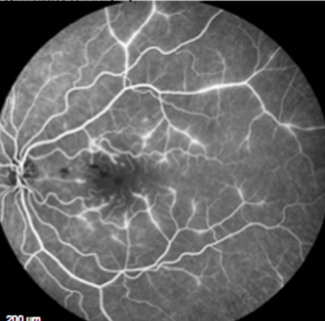
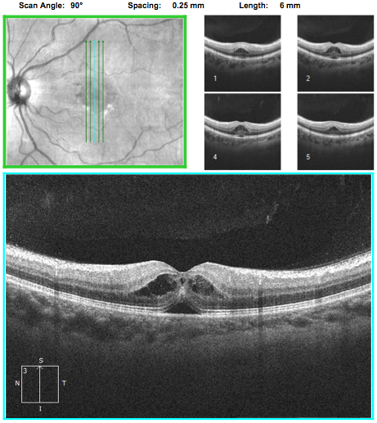
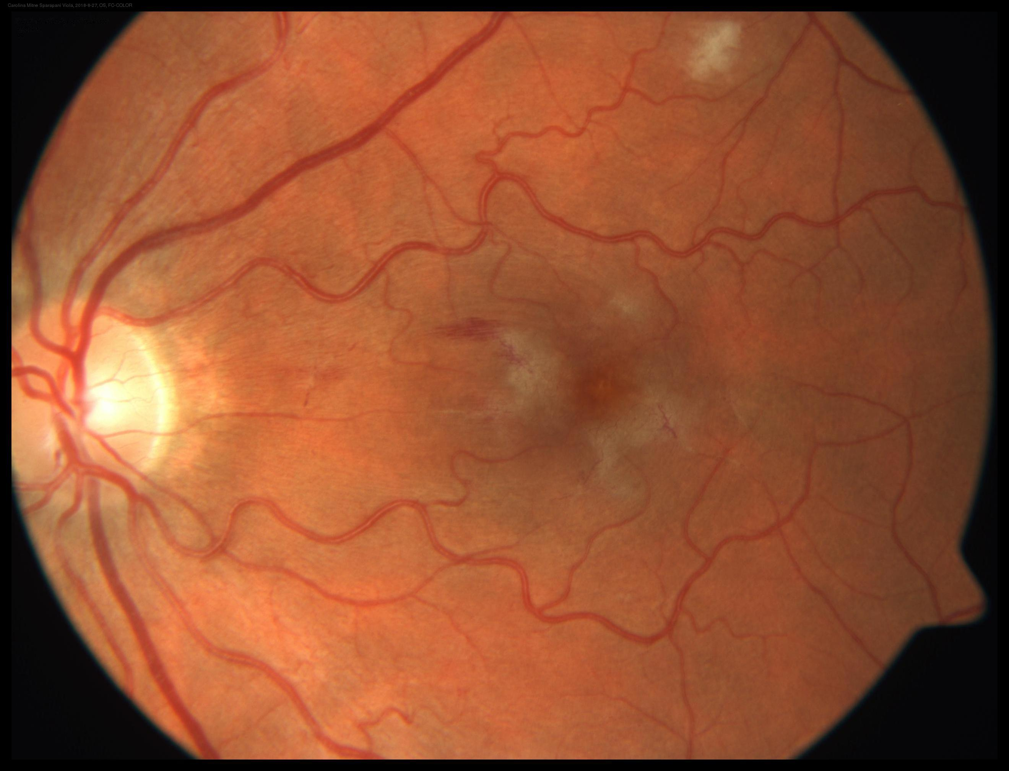
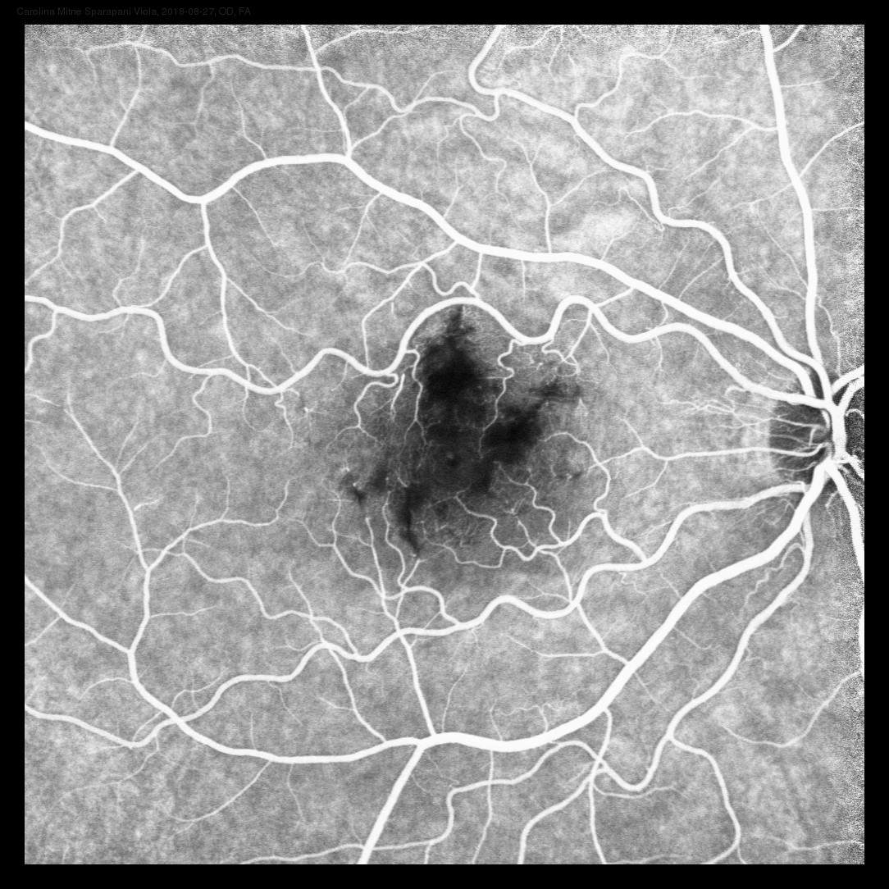
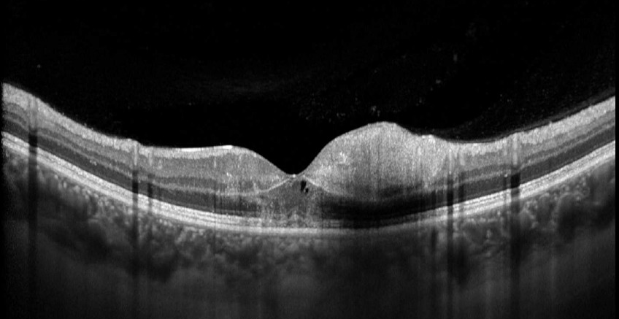
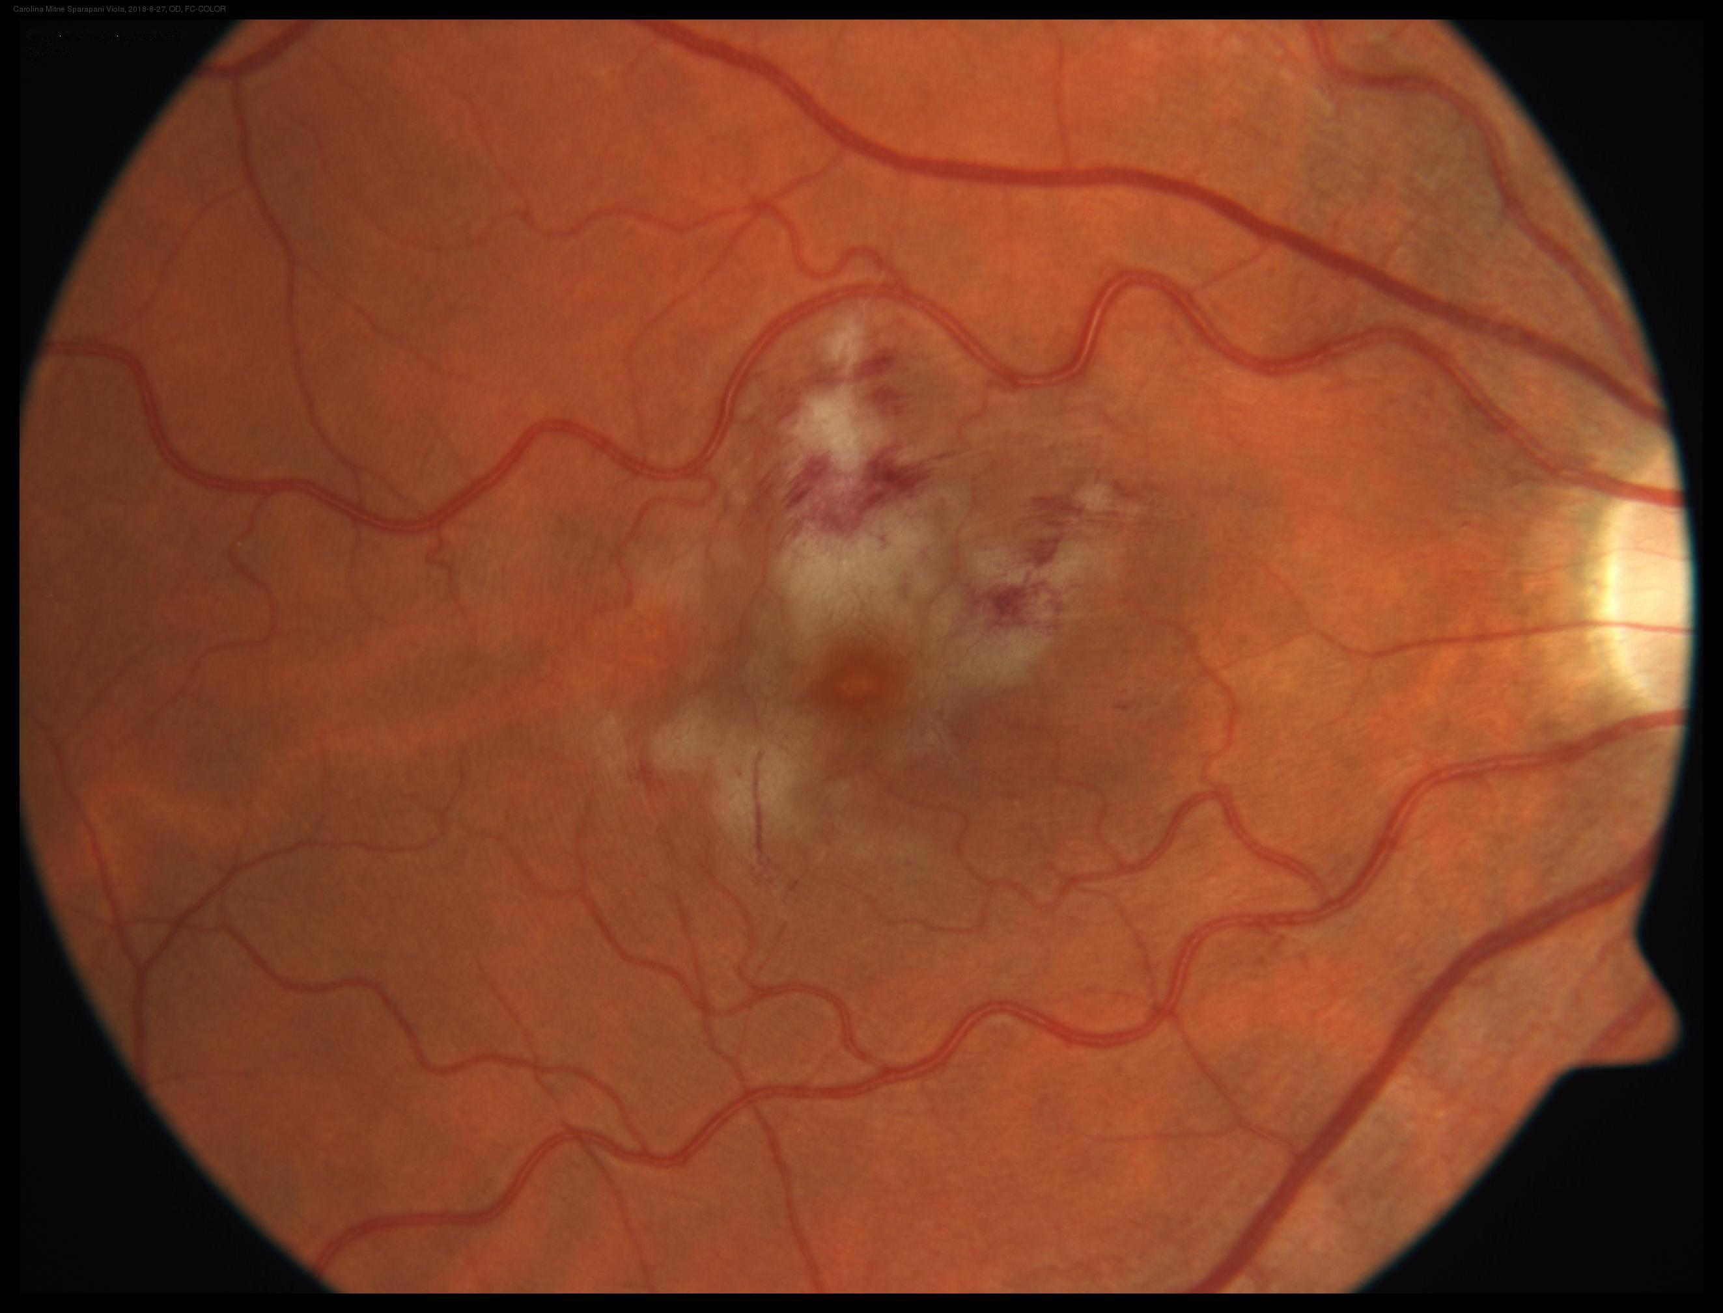
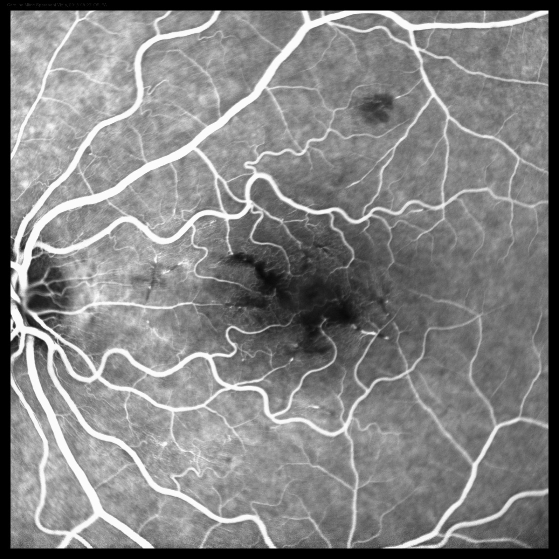
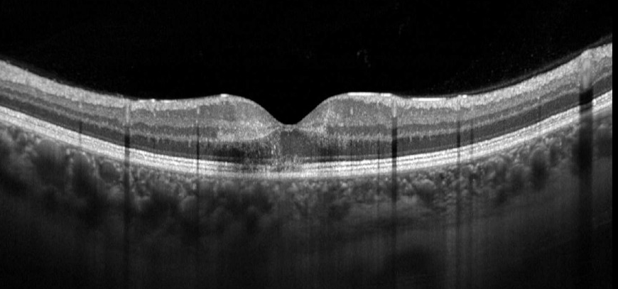
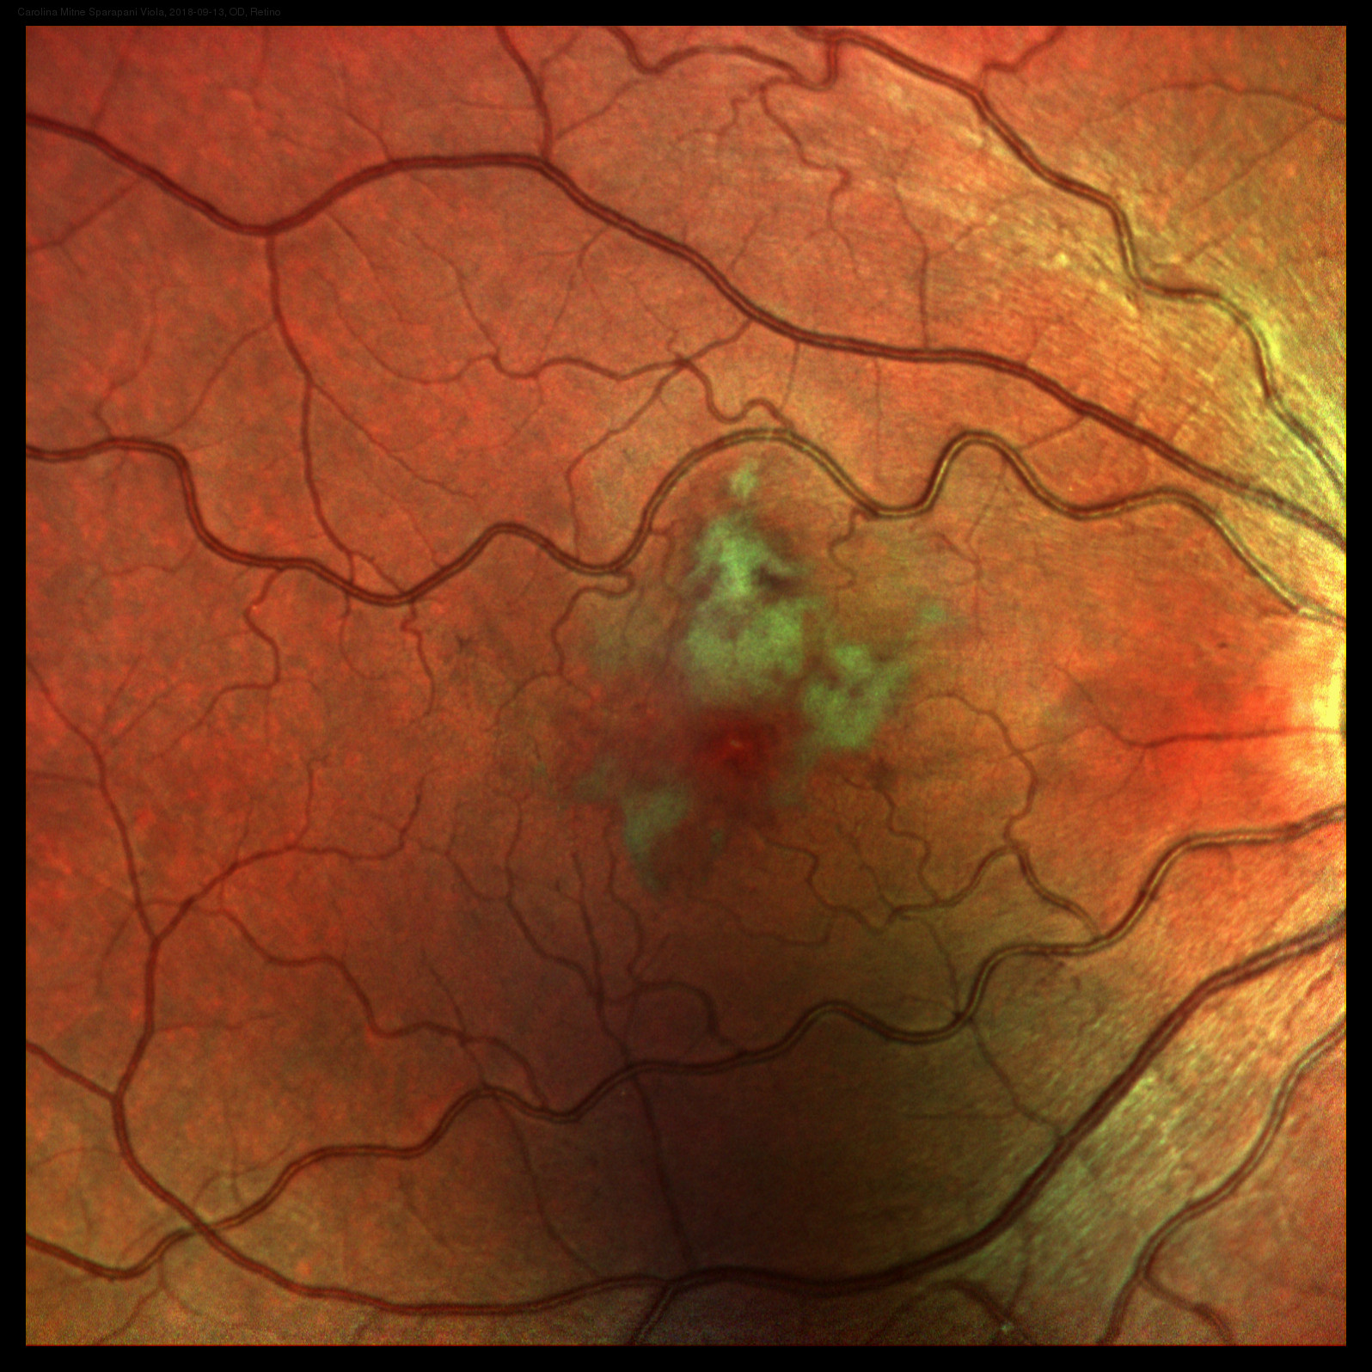
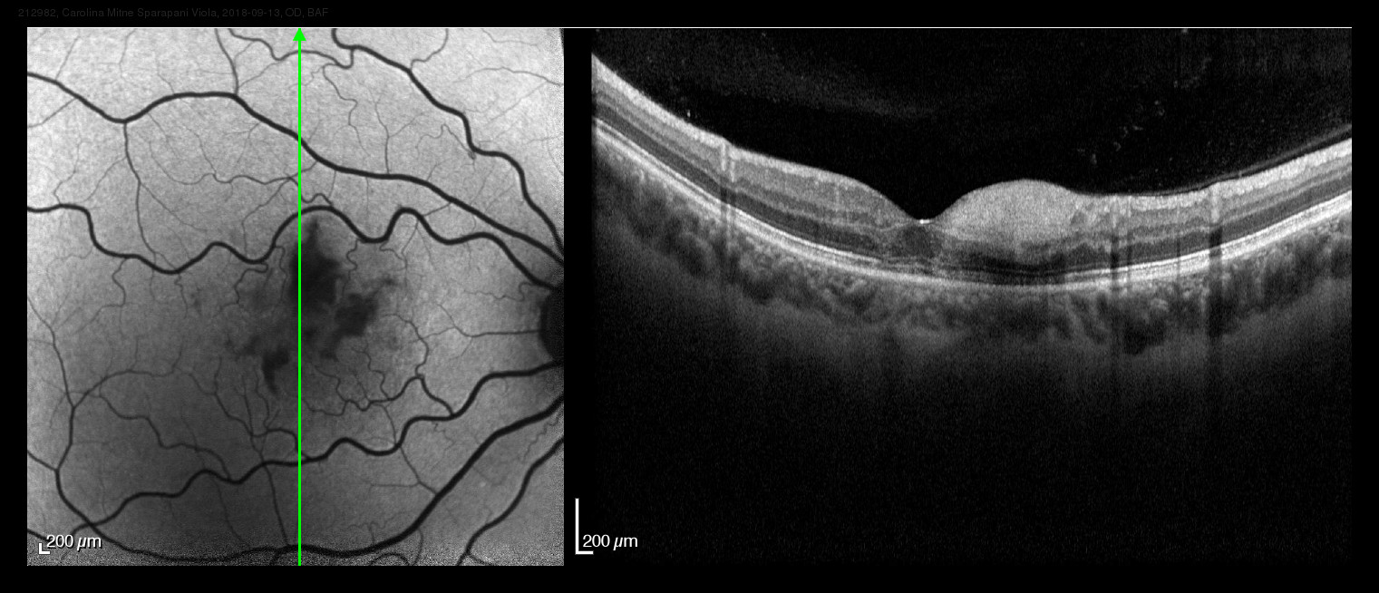
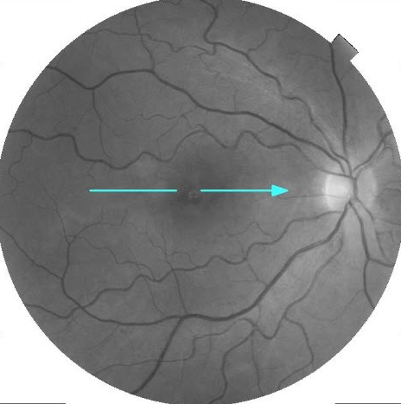
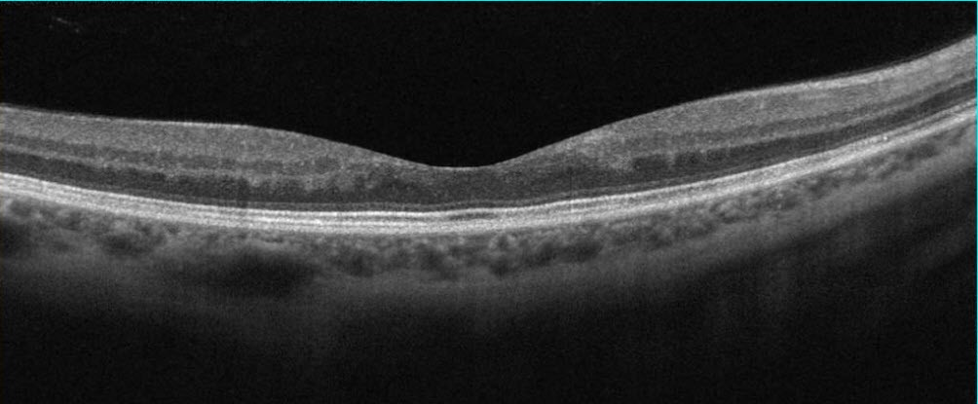
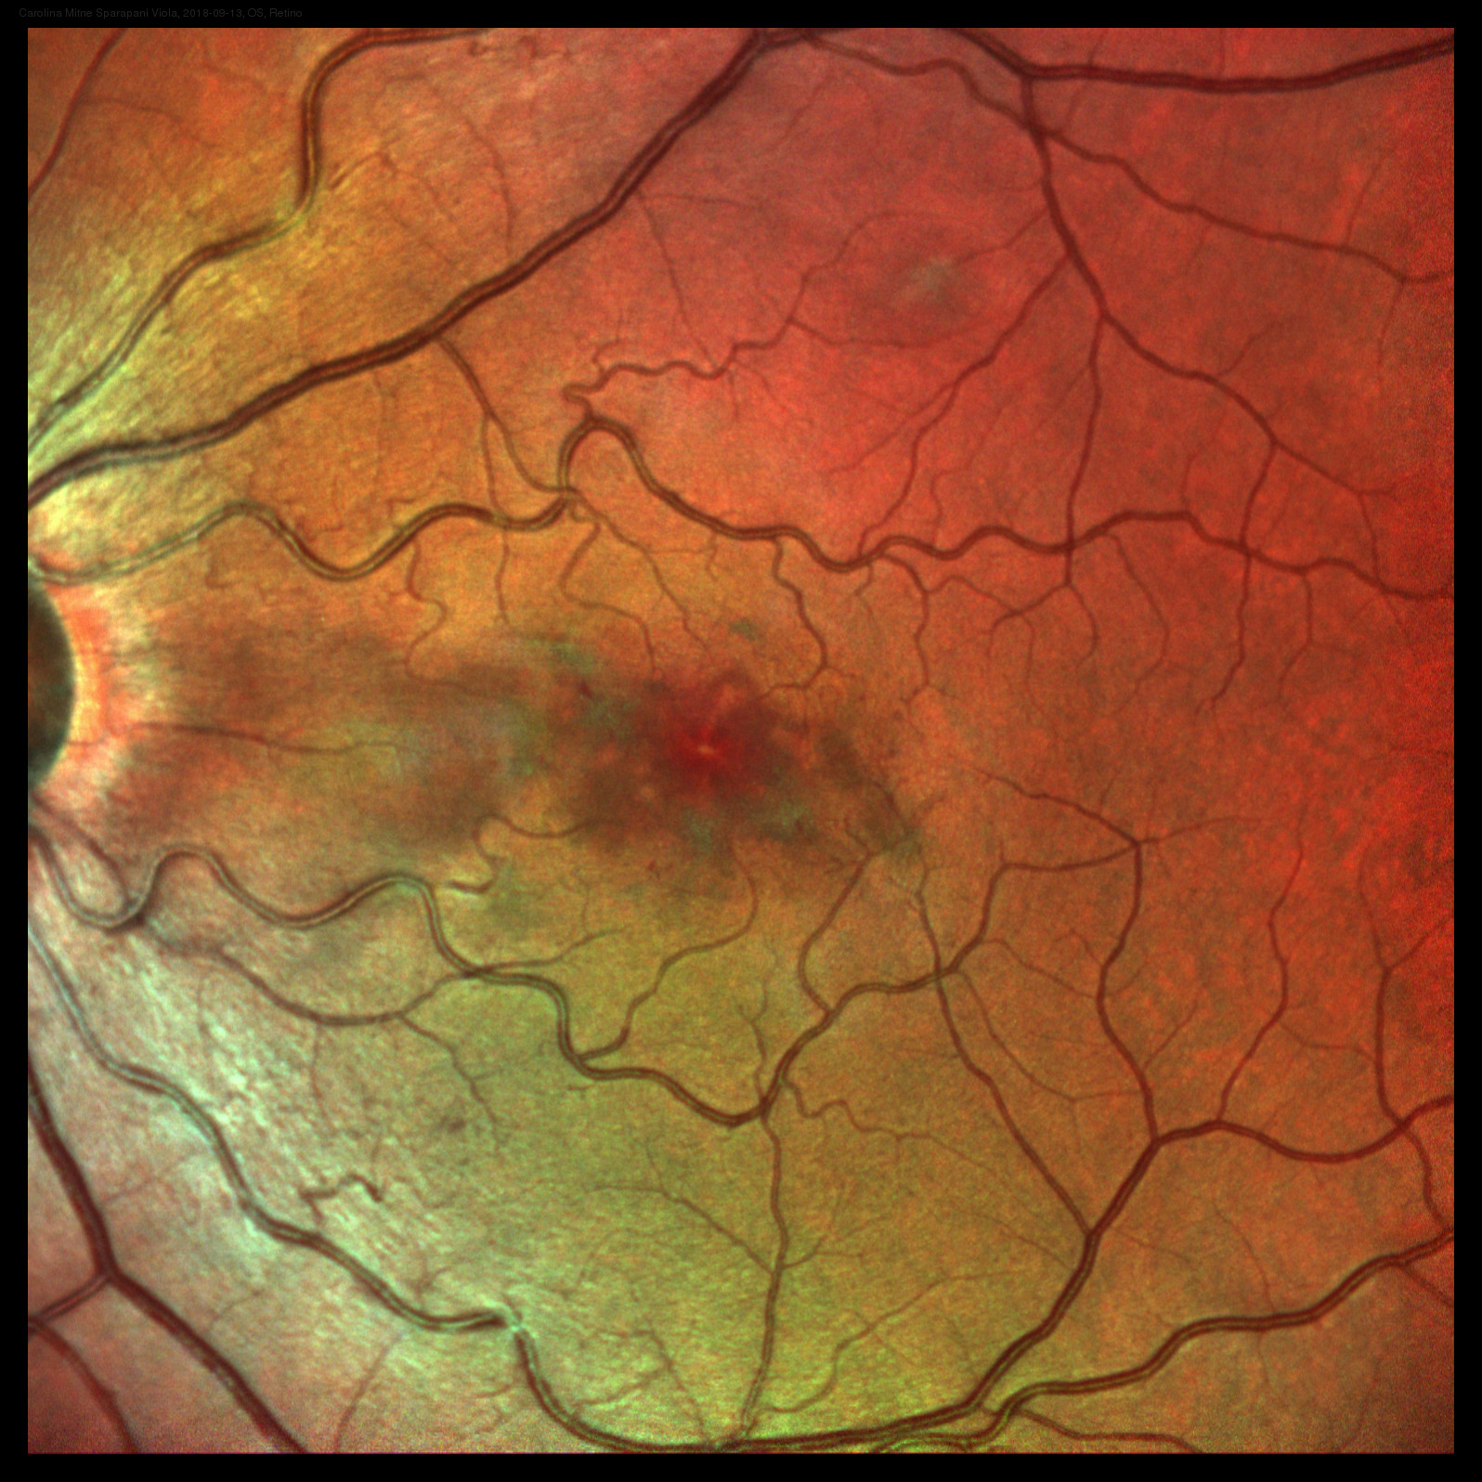
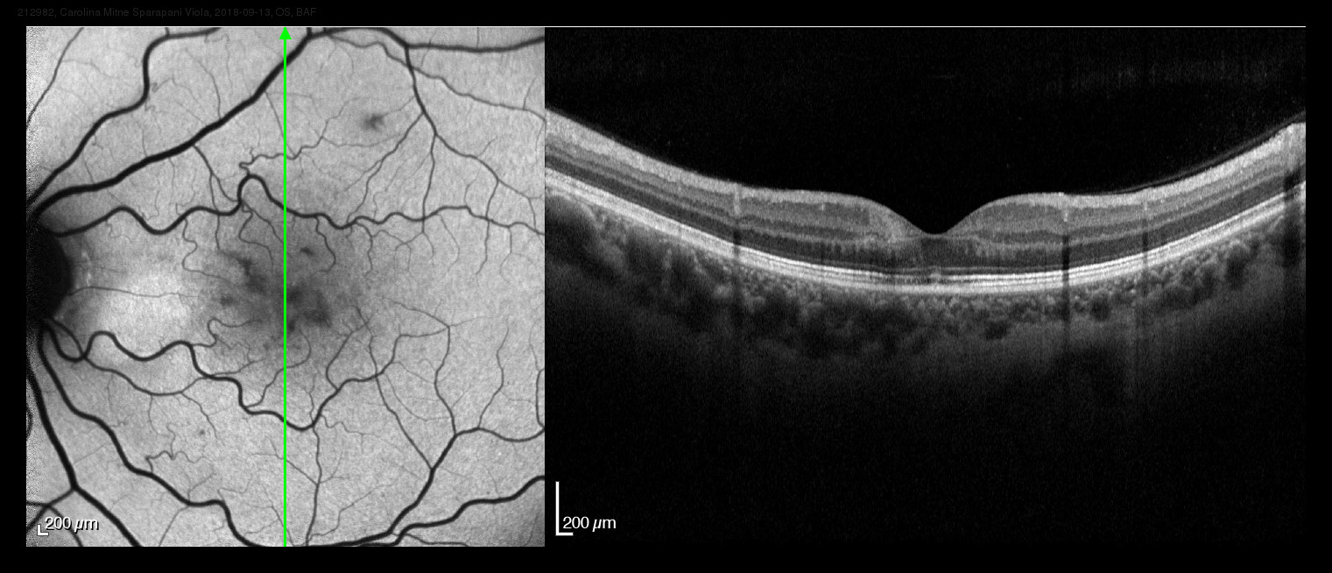
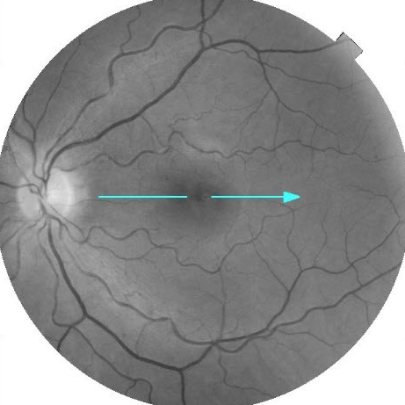
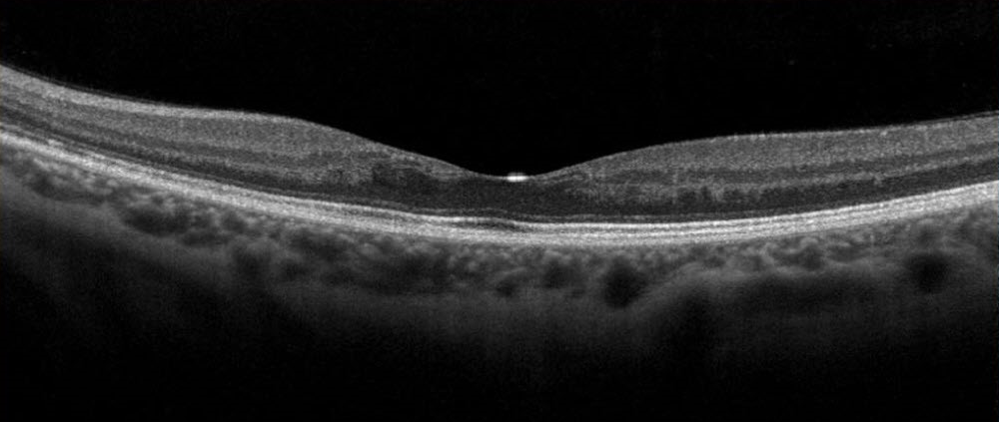
Posterior uveitis with retinal vasculitis secondary to Behçet
disease: a case report
Author and Co-authors: Mariana Davi; Kimble Matos; André Maia; Diogo Souza Domiciano; Somaia Mitne.
INTRODUCTION
FIGURES
Behçet disease (BD) is a systemic vasculitis that affects a large number of organs with a variable spectrum of clinical set. It is a polygenic autoinflammatory disease, of which the etiology is still unclear.
Geographical variation in prevalence and disease expression in addition to the presence of several clinical subsets, account for the difficulty in developing a universal classification criteria. It is known that eye involvement is a relevant factor for diagnosis of Behçet disease.
Right Eye - Before Treatment
1
2
MATERIAL AND METHODS
A
B
C
Here we report a case of posterior uveitis with retinal vasculitis secondary to Behçet disease evaluated with multimodal retinal exams - Fundus Retinography, Angiofluoresceinography and Optic Coherence Tomography (OCT) before and after systemic and ocular treatment.
Left Eye - Before Treatment
CASE REPORT
This case is about a 31-year-old woman with sudden vision loss in both eyes for one day. At the first evaluation, she presented best-corrected visual acuity (BCVA) of 20/100 in the right eye (OD) and 20/60 in the left eye (OS). Slit-lamp examination was normal. Fundoscopy showed tortuous vessels, macular whitish lesions with retinal hemorrhages in both eyes (Figure 1A). Fluorescein angiography demonstrated macular occlusive vasculitis with retinal vein sheathing (Figure 1B). Cystoid macular edema was showed on the optic coherence tomography (Figure 1C).
At medical record review, she reported some episodes of oral painful ulcers during the last year, and genital painful ulcers recently. In biochemical examinations, there were no increase in inflammatory rate, angiotensin-converting enzyme or complement levels. Autoantibodies (antinuclear antibody, antineutrophil cytoplasmic antibody, rheumatoid factor, anti-Ro (SSA), anti-La (SSB), anti-Sm, anti-dsDNA), HLA B-27 and serological tests for infectious diseases (tuberculosis, syphilis, toxoplasmosis, HIV) were negative. Computed tomography imaging of abdomen and thorax revealed no significant abnormalities. HLA-B51 was positive in this patient.
Based on these findings, this case was diagnosed as posterior uveitis and retinal vasculitis associated with Behçet disease. The patient was treated with pulse intravenous (IV) methylprednisolone therapy (1g/day for 3 days) followed by oral prednisone 1mg/kg/day. One week after IV therapy with glucocorticoid a new eye examination were performed, revealing progress of macular ischemia (Figure 2). Additionally, an injection of dexamethasone implant in the right eye was performed (the eye with the worst visual acuity).
BCVA was 20/200 in the OD one month after treatment, despite dexamethasone implant, and improved to 20/20 in the OS. After the initial treatment, the patient was given the TNF blockade agent infliximab (5mg/kg intravenous every 8 weeks). There was a resolution of vasculitis and macular edema in both eyes, however, visual acuity in the right eye did not improve possibly due to foveal ischemia (Figure 3). The clinical ocular condition remains stable and in remission (Figure 4).
A
B
C
Figure 1 - A: Fundoscopy; B: fluorescein angiography; C: macular OCT
Right Eye – After pulsotherapy
A
B
C
Left Eye – After pulsotherapy
A
B
C
Figure 2 - A: Fundoscopy; B: fluorescein angiography; C: macular OCT
Right Eye – After dexamethasone Implant
Right Eye – Current macular status
A
B
A
Left Eye – NO dexamethasone Implant
Left Eye – Current macular status
DISCUSSION
The patient of this case had oral and genital painful ulcers plus ocular involvement (posterior uveitis) leading to diagnosis according to the International Study Group for Behçet Disease (ISBC) criteria². Aiming to prompt decrease inflammatory exacerbations and recurrence, treatment was performed following EULAR recommendations such as systemic glucocorticoids and monoclonal anti-TNF antibodies expecting a rapid response end improvement of visual acuity.³ Ocular treatment with dexamethasone implant in the OD was chosen due to the poor response to the systemic corticosteroids and immunosuppressive agents.^{3, 4}
A
B
B
Figure 3 - A: Fundoscopy; B: macular OCT
Figure 4 - macular OCT
1. Yazici H, et al. Behçet syndrome: a contemporary view. Nat Rev Rheumatol. 2018;14:107.
2. International Study Group for Behçet’s Disease. Criteria for diagnosis of Behçet’s disease. Lancet 335, 1078–1080 (1990).
3. Erol Coşkun MD, et al. Intravitreal Dexamethasone Implant for Treatment of Refractory Behçet Posterior Uveitis: One-year Follow-up Results, Ocular Immunology and Inflammation, 23:6, 437-443 (2015)
4. Hatemi G, et al. 2018 Update of the EULAR recommendations for the management of Behcet's syndrome. Ann Rheum Dis. 2018;77(6):808–18.
REFERENCES
CONCLUSION
Therefore, our case highlights the need for early diagnosis and management in ocular Behçet, especially with posterior uveitis, in order to prevent severe and permanent visual damage.
FINANCIAL SUPPORT
The authors declare no financial support or conflicts of interests.

