Slide 1
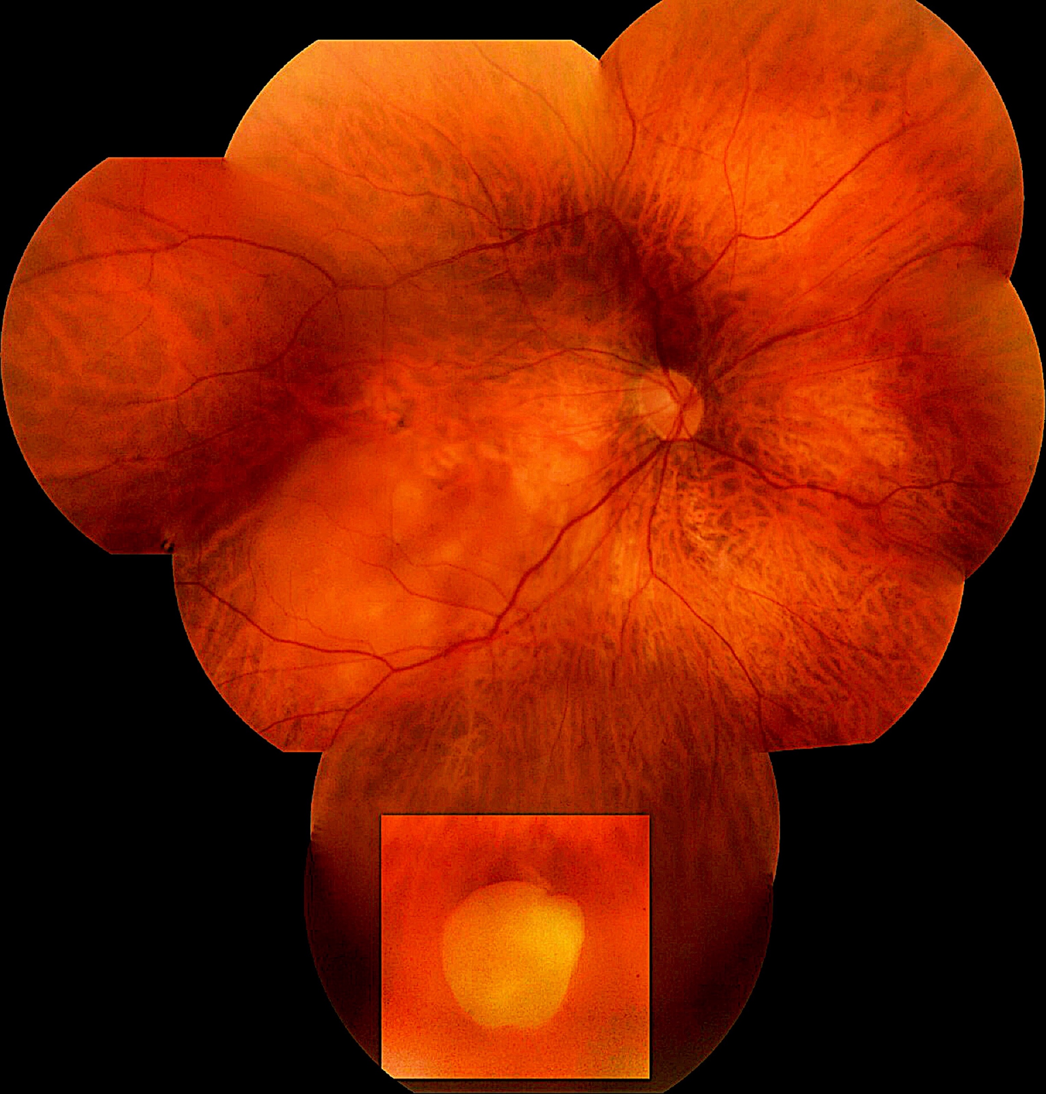
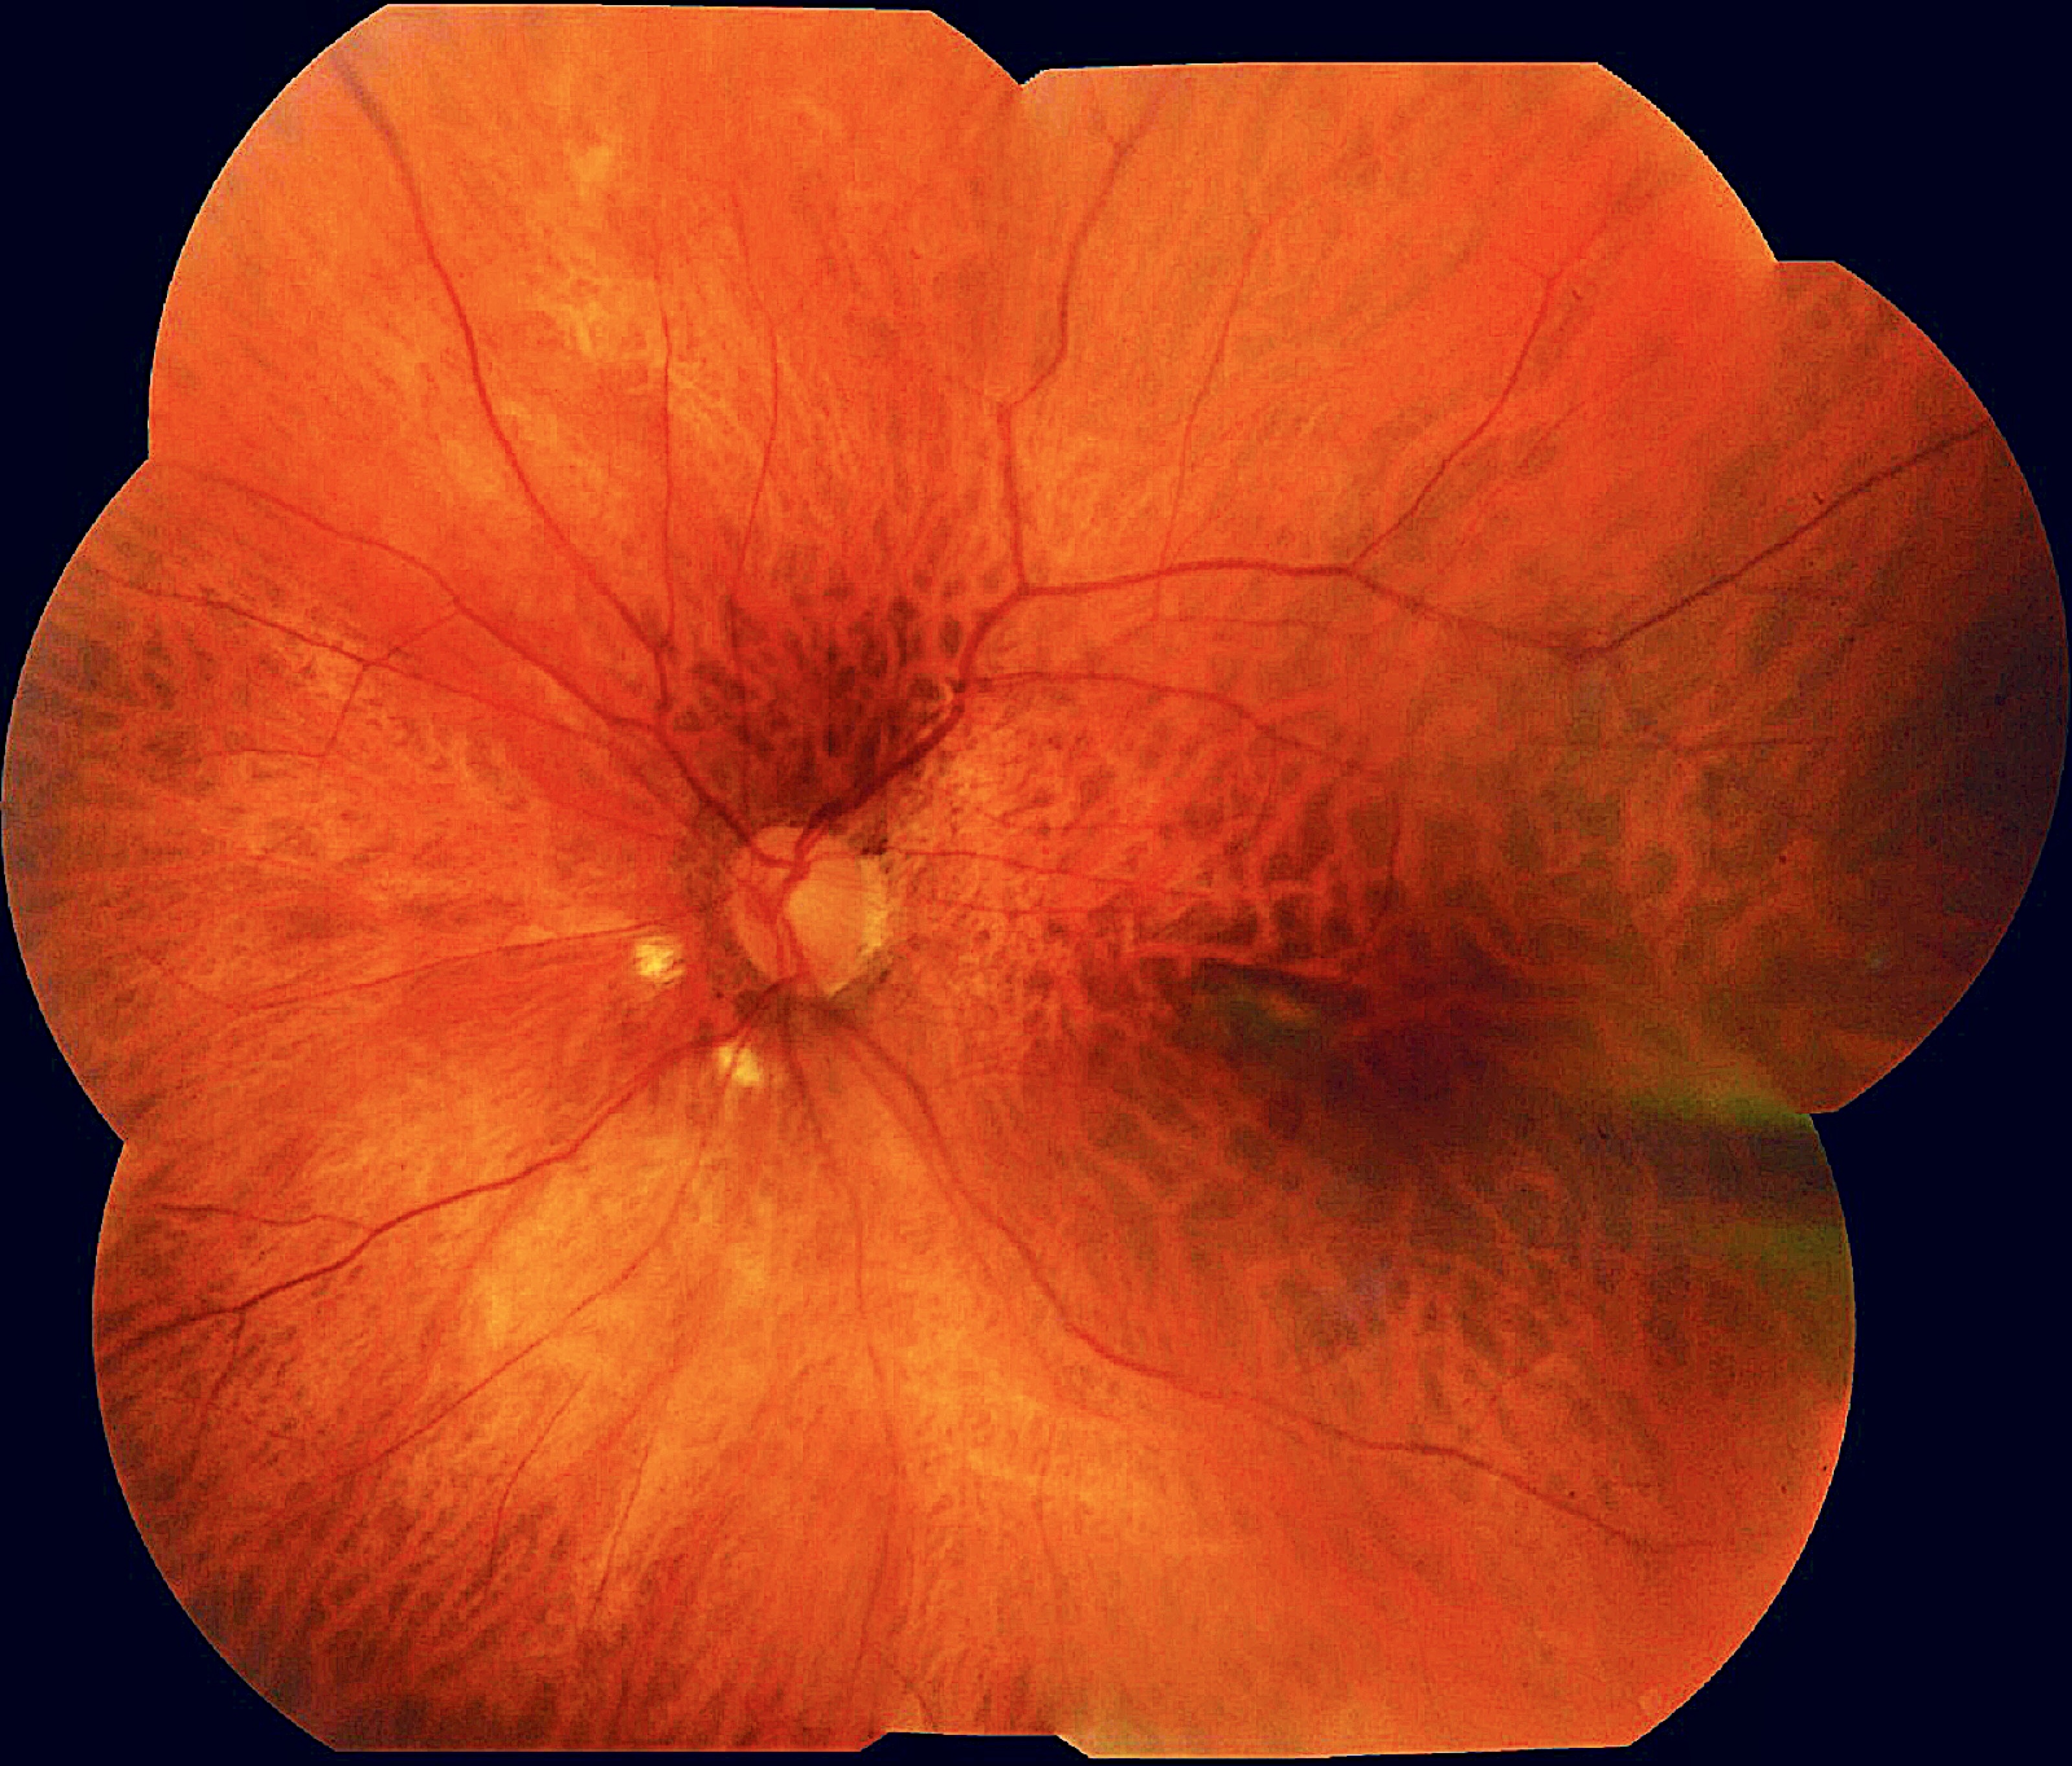
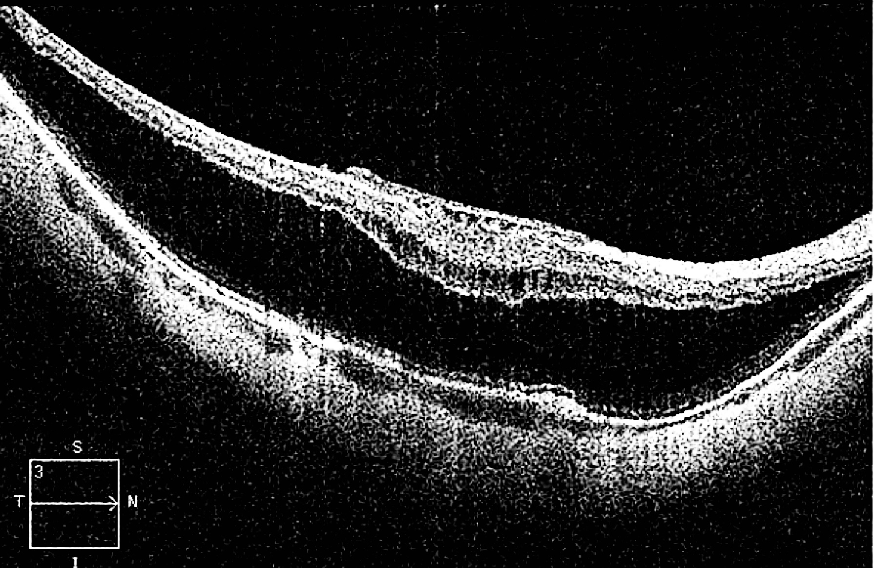
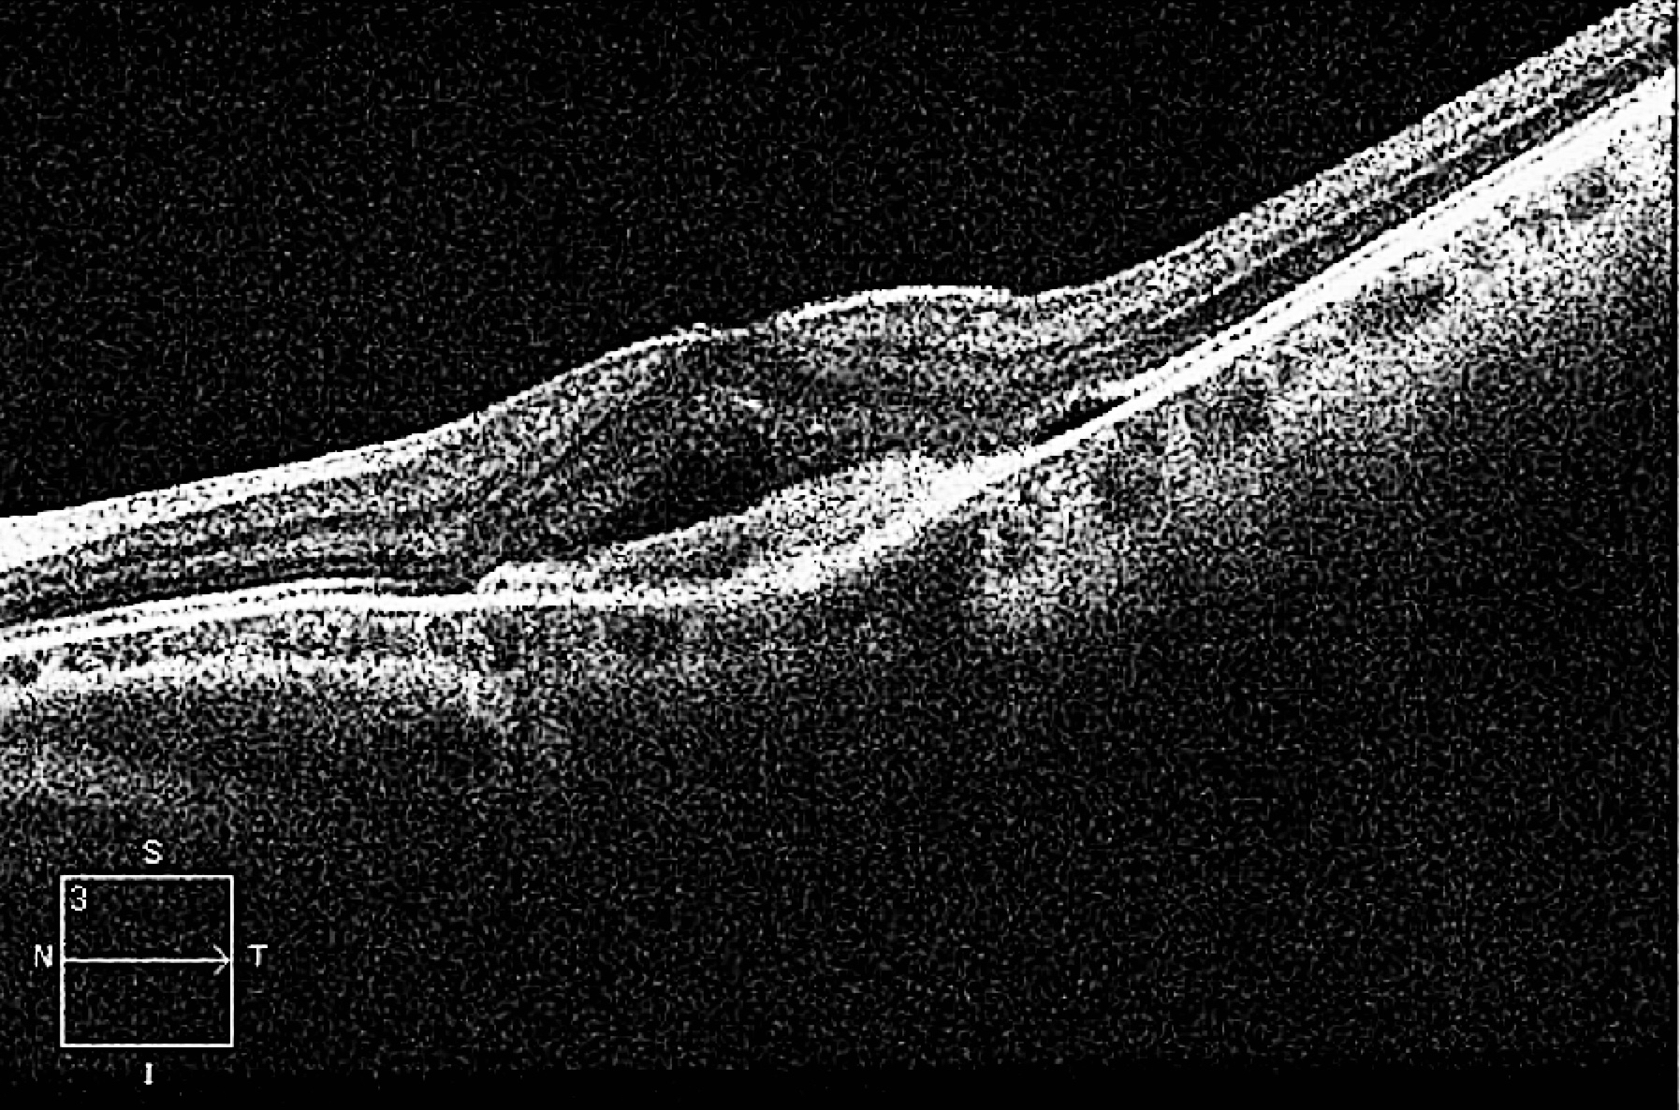
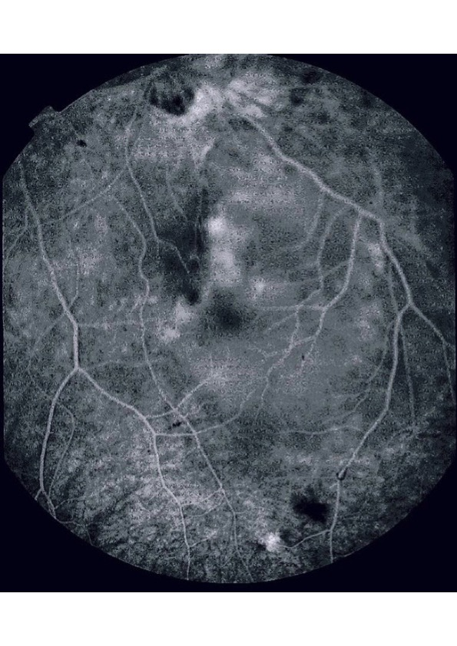
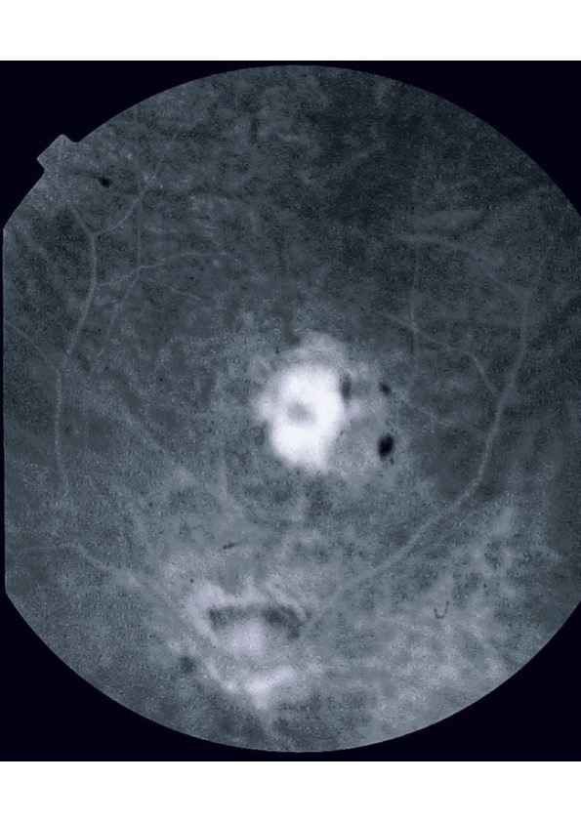
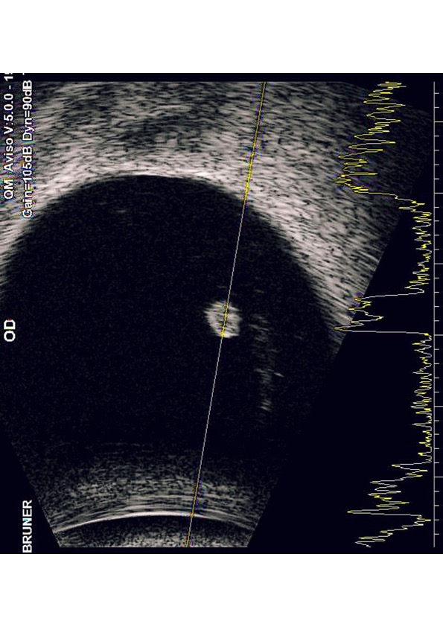
Vitreous Cyst, Foveoschis and Neovascular Membrane in high myopia : A Case Report.
Carolina Maria Barbosa Lemos, Rafael Garcia, Walther de Oliveira Campos Neto, Fernanda Salata Antunes,Beatriz Mencaroni, Anésio Ruiz Neto, Mariana da Rocha Martini, André Marcelo Vieira Gomes.
PURPOSE
Angiofluoresceinography (AF): macular hyperfluorescence in OD and hyperfluorescence by staining in OE. Ultrasonography (OD): rounded cystic image with mobile hypoechoic content inside the vitreous cavity, with medium reflectivity. Findings suggestive of vitreous cyst, with 2.3 mm in the largest diameter. Laboratory tests, serology and cranial tomography: normal.
To describe a case of Vitreous Cyst.
INTRODUCTION
The first description of a vitreous cyst (CV) was made in 1899 by Tansley [1]. They were mainly classified as congenital and acquired. Congenital CVs originate from remains of the hyaloid artery or glial remains of Bergmeister's papilla [2]. Acquired CVs, on the other hand, are secondary to diseases that alter the RPE metabolism, [3]. In retinoschisis, the external plexiform layer separates from the internal nuclear layer and can present as a cyst or as an area of peripheral cystoid degeneration [ 4].
DISCUSSION
The formation of cysts is more common after retinal detachment, as there is a contraction of the internal limiting and internal layers of the retina. This causes folds in the retinal layers and the formation of cystic changes [4]. In retinoschisis, the formation of cysts can occur anywhere where traction occurs through a vitreous membrane. This is what probably occurred in the case reported, since USG b-scan excluded the presence of vitreous embryonic residues - which speaks against the possibility of being a congenital CV.
Fig. 1 and 2: retinography of the right eye
METHODS
Medical records review
RESULTS
Fig 3 and 4 : OCT of the Right and left eye
A 50-year-old woman reported severe progressive visual acuity in both eyes. Corrected visual acuity: CD 1.00m / 20 / 100. Biomicroscopy: phakic, absence of Mittendorf stitch. Fundoscopy of the right eye(OD): pigmented alteration of the macula, diffuse atrophy of the RPE, rounded, yellowish and mobile cyst, free in the vitreous cavity, applied retina.Fundoscopy of left eye (OS): macular Foster-Fuchs stain. In the OCT OD: myopic foveosquise. OCT OE: MNVSR without signs of activity.
Fig 5 and 6 : AF of the Right and Left eye
BIBLIOGRAPHY
1-Tansley JO. Cyst of the vitreous. Transactions of the American Ophthalmological Society. 1899;8:507–509.
2-Orellana, J., O'malley, R. E., Mcpherson, A. R. & Font, R. L. (1985). Pigmented free- oating vitreous cysts in two young adults: electron microscopic observations. Ophthalmology;92: 297-302.
3-Cruciani, F., Santino, G. & Salandri, A. (1999). Monolateral idiopathic cyst of the vitreous. Acta Ophthalmologica Scandinavica; 77: 601-603.
4-Retinal Cysts and Retinoschisis by
C. G. KEITH - Department of Pathology, Institute ofOphthalmology, University of London.
Fig 7 and 8 : USG of Right eye.
Notes:
purpose, methods, results and discussion

