Slide 1
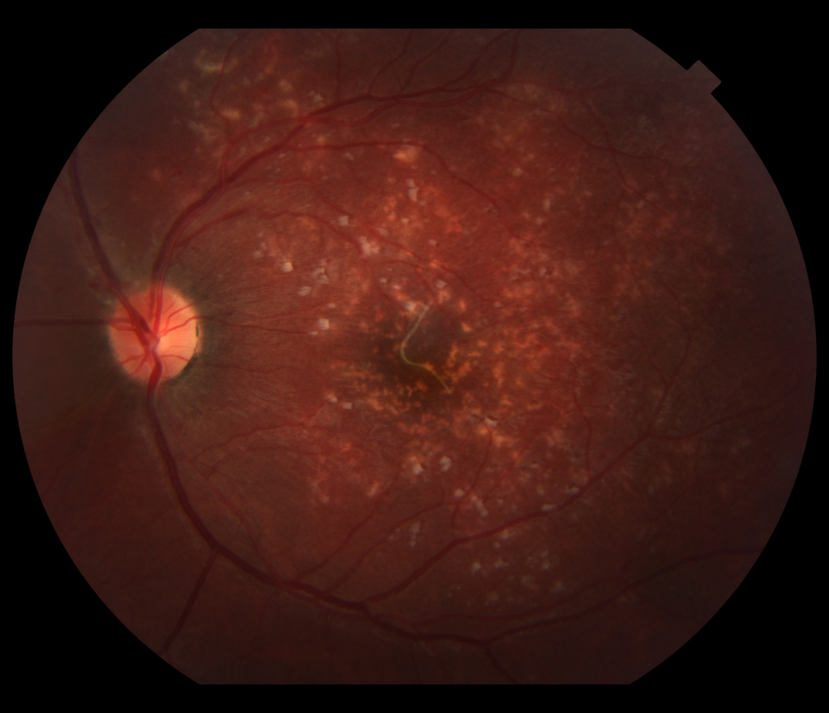
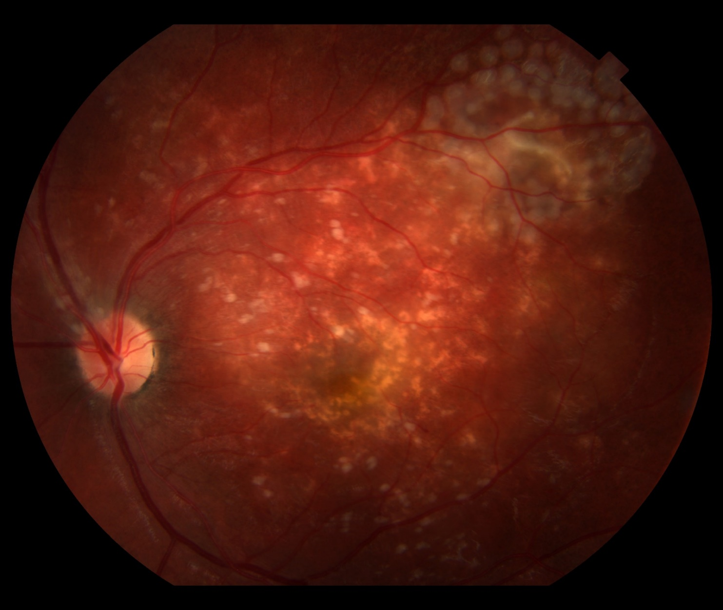
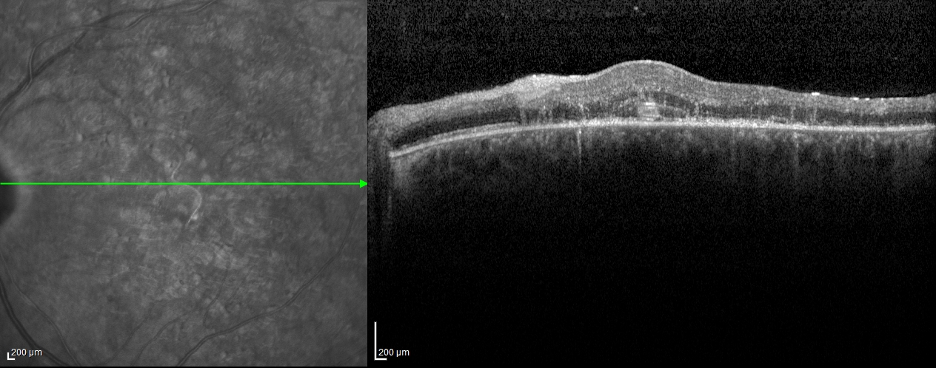
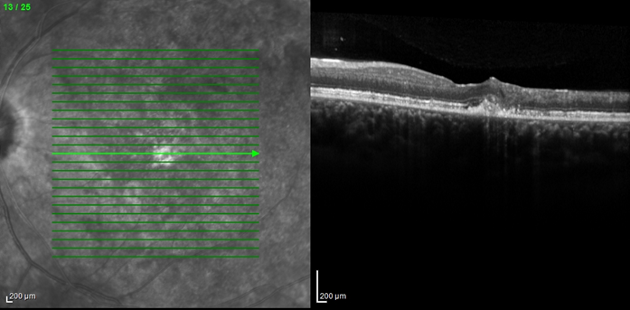
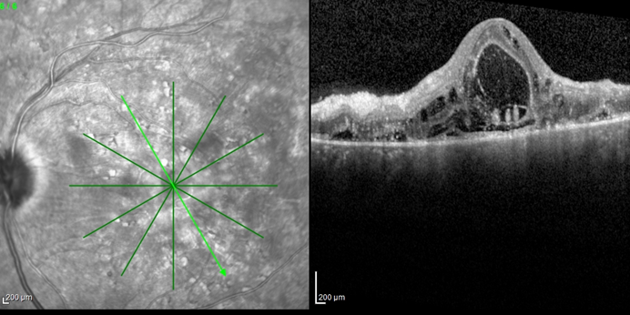
OPTICAL COHERENCE TOMOGRAPHY (OCT) DOCUMENTING a motile nematode worm in subretinal space: a case of unilateral Diffuse Subacute Neuroretinitis (DUSN)
Ana Luísa Reis Melo, Rafael Conrado Rocha de Oliveira, Andressa Castelo Branco Araújo Bernal, Tadashi Ono Junior, Polyana Queiroz Alvarenga, Aline Silva Lobato, Gilberto Pereira Resende, Mário José Carvalho
Instituto de Saúde Ocular (ISO OLHOS) – Uberlândia-MG
PURPOSE
IMAGES
To evaluate a case of unilateral Diffuse Subacute Neuroretinitis (DUSN) through register done by Optical Coherence Tomography (OCT) from diagnosis to management.
METHODS
Case report of a patient of Instituto de Saúde Ocular (ISO) of Uberlândia - MG, associated with a literature review.
RESULTS
A 17-year-old man presented with complaint of acute vision loss in the left eye (OS) four days before. The patient was systemically well. Ocular examination revealed a best-correct visual acuity of counting fingers at 2m in OS. Fundus examination of this eye showed edema and exudative lesions, mainly in the posterior pole. And a presence of a motile nematode worm in macular subrretinal space, which contraindicated immediate photocoagulation (Figure 1 and 2). Albendazole therapy at daily doses of 400 mg was initiated. The next day, the worm was hypoactive but still in macular area (Figure 3). In order to prevent the death of the parasite in this topography, we decided to suspend Albendazole and wait for the worm to resume mobility. After 48 hours the worm had migrated to the superotemporal region of posterior pole, allowing the worm to be surrounded by laser photocoagulation, which ended up in its succeful destruction (Figure 4). Oral Albendazole 400mg/day for 30 days and oral Prednisone 40mg/day with programmed reduction were initiated. The exudative retinal lesions improved in about 2 weeks. The late retinal findings by OCT are retinal nerve fiber layer atrophy, Retinal Pigment Epithelial (RPE) abnormalities and epiretinal membrane (Figure 5).
FIGURE 1: Retinal exudative lesions and the nematode worm in macular subrretinal space (First day).
FIGURE 4: 48 hours after Albendazol was discontinued. Worm succefully destroyed after laser photocoagulation had been apllied.
FIGURE 2: OCT image showing a worm in macular region. (First day).
00000000
:
FIGURE 5: OCT image showing loss of photoreceptor layer and RPE in the macular region, in addition to small subretinal fibrotic tissue (45 days post diagnosis).
DISCUSSION
Documentation of the initial phase of DUSN is rare in literature. In this case, we had the opportunity to make video and photographic register with OCT. This serial tomographic follow-up provided data on the worm's behavior in the subretinal space, on the regression of retinal edema and the evaluation of retinal damage. In addition, the action of Albendazole in reducing worm mobility was demonstred and its subsequent migration to the extramacular region, after the drug was discontinued.
FIGURE 3: Presence of worm in external retina in addition to foveal edema (1 day after prescription of Albendazole)
REFERENCES
1- Ryan SJ, Schachat AP. Retina. 3ª ed. St Louis: CV Mosby: 2001:1669–1678.
2- Filho CAAG, Garcia, CAA, Arevalo JF. Imaging in the Diagnosis and Management of Diffuse Unilateral Subacute Neuroretinitis. International ophthalmology clinics. 2012.

